Slide 1
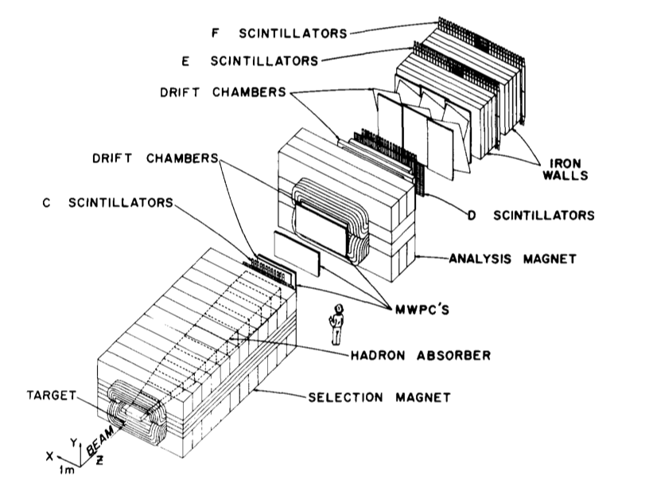
Extreme Structure Functions…
“Twist and Shout” with E615
JEP
September 22, 2012 Jim Alexander

Slide 2


Historical Context, ca. 1975-1980
Early Drell-Yan experiments confirmed basic (“naïve”) picture
massless,
asymptotically free
Key features:
  Quarks: massless, spin ½, 3 colors, 1/3, 2/3 charges, etc
  Pions: valence quark content and structure function extractions
Three back-to-back Phys Rev Letters by JEP et al:
Production of Muon Pairs by 225-GeV pi+-, K+, p+- Beams on Nuclear Targets. PRL 42, 944 (1979)
Comparison Of Muon Pair Production To The Quark - Anti-quark Annihilation Model. PRL 42, 948 (1979)
A Determination of the Pion Structure Function from Muon Pair Production. PRL 42, 951 (1979)

Slide 3
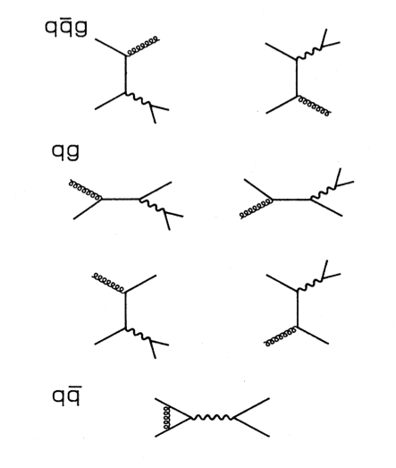
More Historical Context: The plot thickens
The naïve model was recognized as naïve.
  QCD corrections must enter!
First order diagrams:
  Initial state gluon radiation
  Alternative production channels, eg compton-diagrams
  Vertex corrections
Consequences rather mild:
  K factor boosts cross section
  Mupair P_{T} generation
  Some modifications to angular distributions

Slide 4
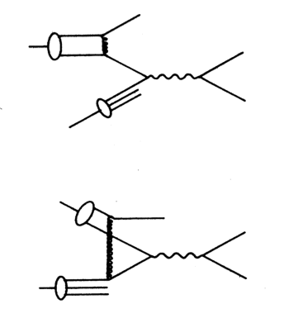
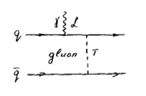
But that wasn’t all…
Growing understanding that internal gluon exchanges – effects of the pion bound state – should have observable effects
  “Higher Twist” contributions
Key observation: x→1 is linked to high q² gluon and off-shell quark.
(x=momentum fraction of quark in pion)
But quark with large p²=m² will bring new terms to the amplitude that were previous neglected in m=0 approximation: coupling to longitudinal vector boson.
Farrar & Jackson, PRL 45, 1416 (1975)
Vainshtein & Zhakarov, PLB 72, 368 (1978)

Slide 5
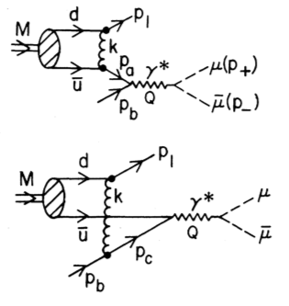

Berger & Brodsky: pion at x→1
Quark Structure Functions of Mesons and the Drell-Yan Process, PRL 42, 940 (1979)
Explicit calculation of hadronic component in πN→μμ interactions – ie the structure functions
Prediction for longitudinal photon polarization, angular distributions
μ⁻
u
θ
u
pion
nucleon
μ⁺

Slide 6
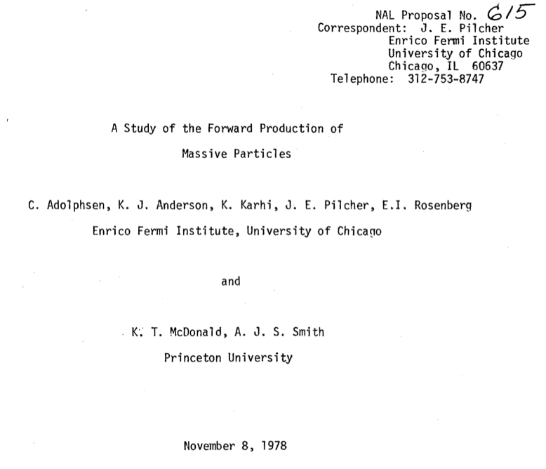
Coincidentally,…

Slide 7
Coincidentally,…
Muon Pairs
“Phase II”

Slide 8
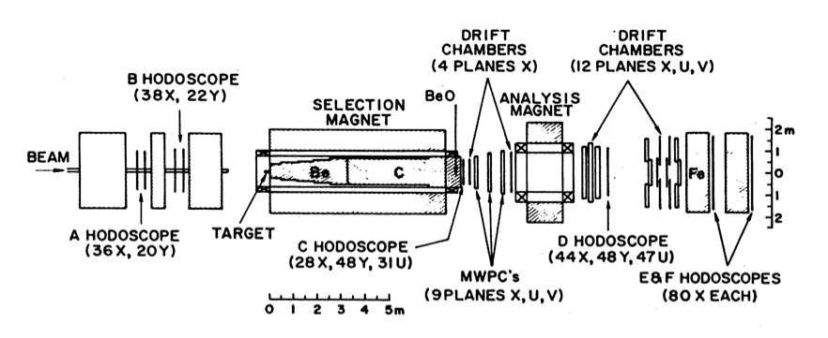
E615, 1980-?
Distinction between sin²θ and 1+cos²θ is mainly at high |cosθ|
Experiment required good acceptance for one high momentum, (straight-ahead) muon, and one low-momentum (large-angle) muon. Beam muons serious background, design issue.
“Capture and measure” design

Slide 9
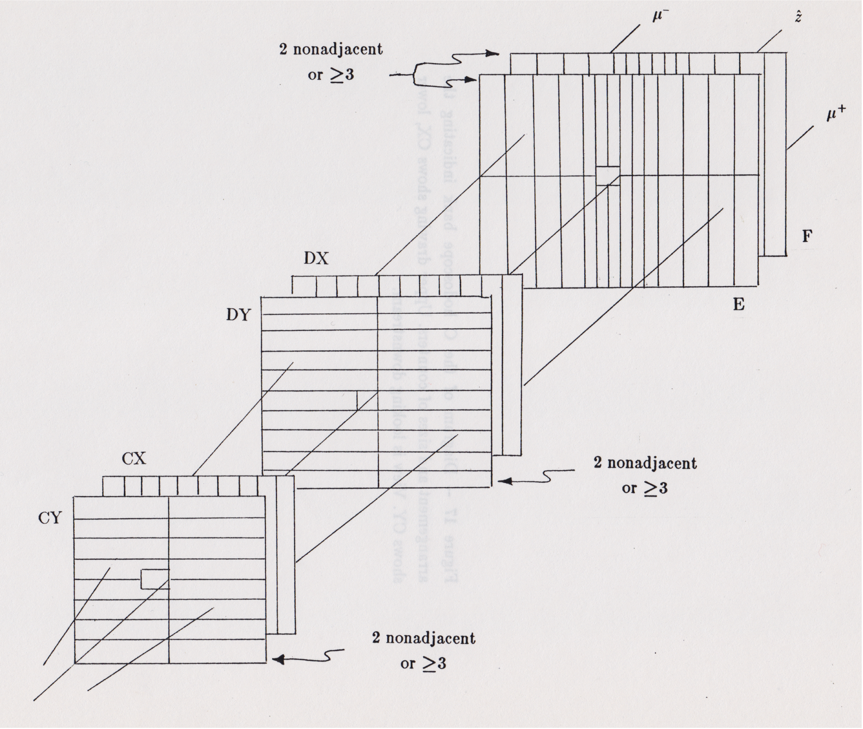
Scintillator planes & trigger
Level I: 2 distinct tracks, in time
Level II: point back to target in y
Level III: M_{μμ} > 2 GeV (lookup)

Slide 10
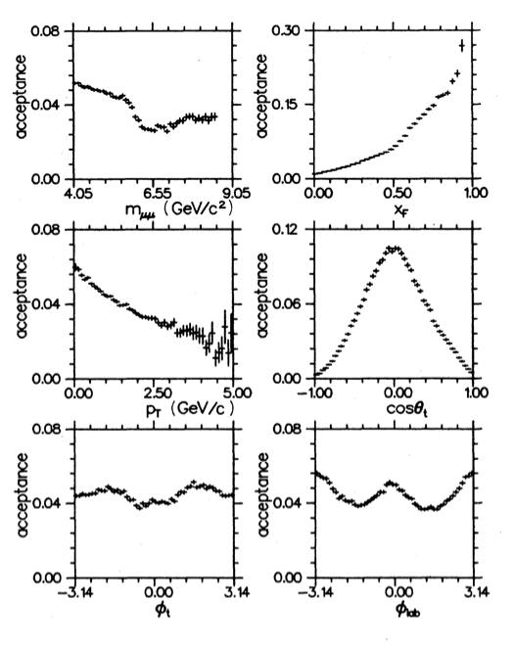
E615 Performance
Excellent acceptance at high x
Sufficient at high |cosθ|
  Limited by aperture and beam hole

Slide 11
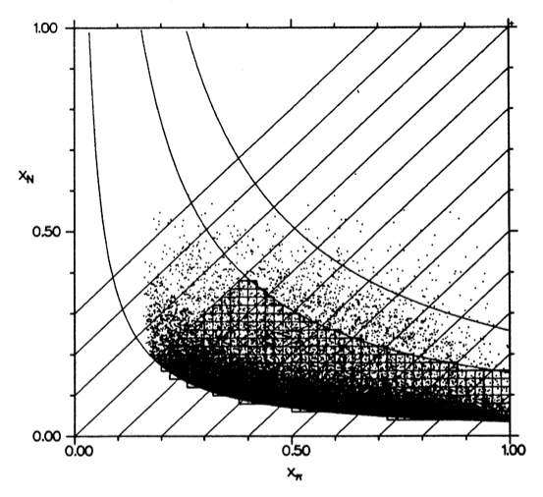
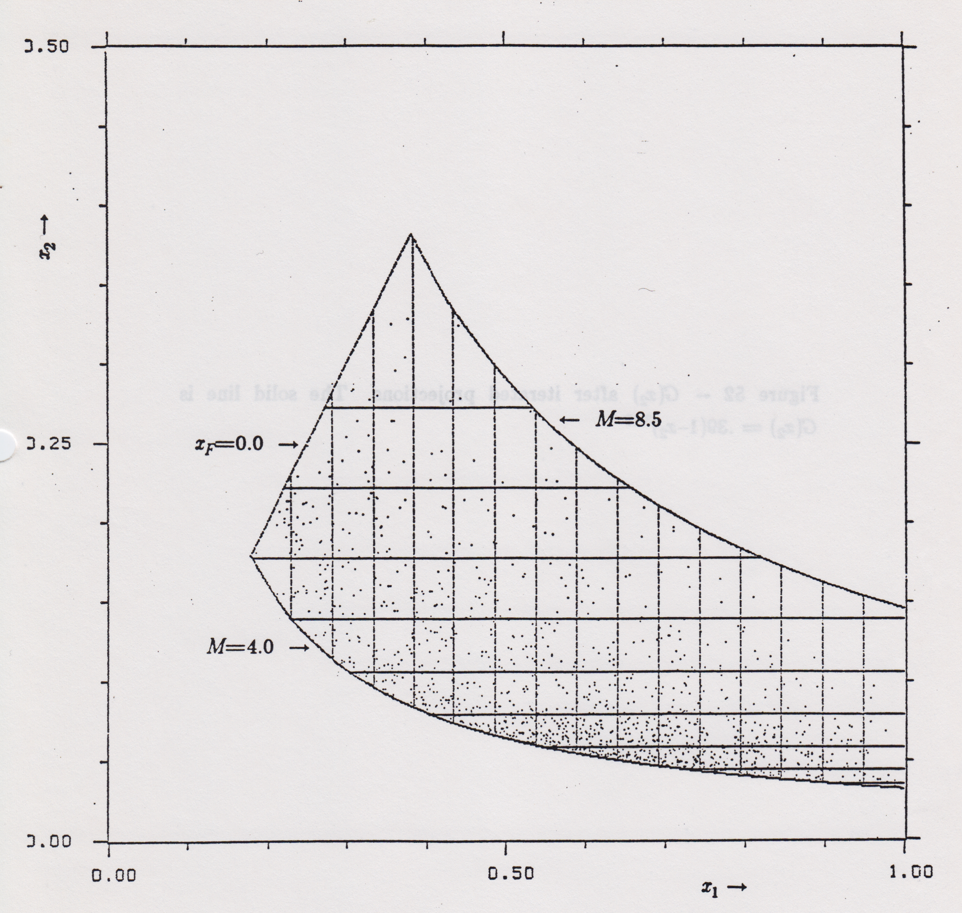
Plenty of data
Plot each mupair as point in x_{π}-x_{N} plane.
Phys Rev D 39, 92 (1989)
36k events
x_{N}
11 GeV
Engineering Run 1983
8.5 GeV
1k events
4 GeV
x_{π}

Slide 12
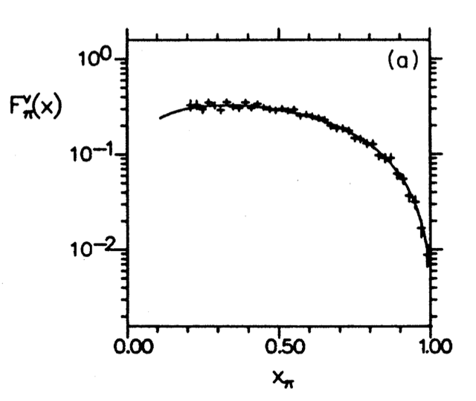
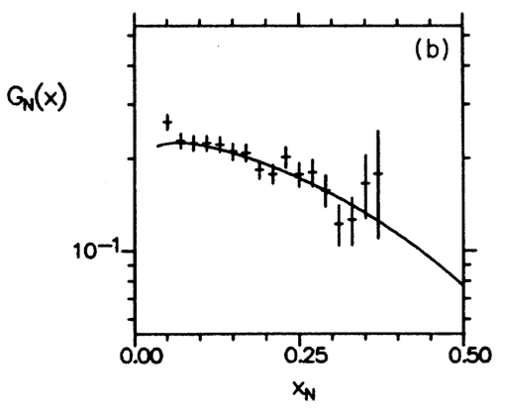
Structure Functions
Project onto x_{π}, x_{N} axes, correct for acceptance, efficiency…
Pion
Nucleon

Slide 13
Structure Functions
The “low mass anomaly”
Low x_{N}, low mass → high x_{F}, low M_{μμ}
Supported by other measurements (NA3)
Pion
Nucleon

Slide 14
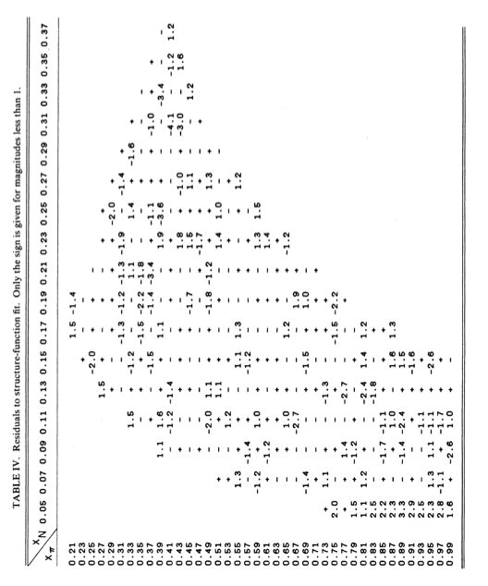
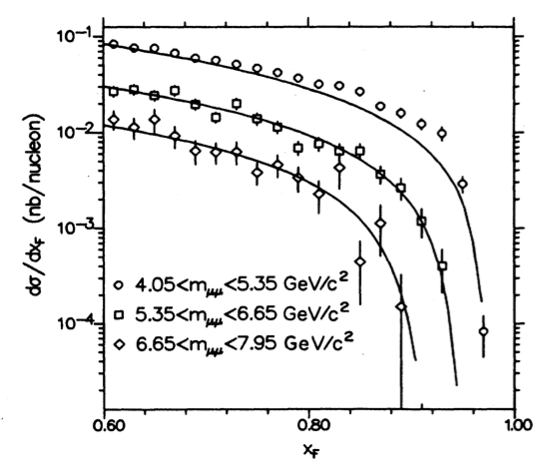
The anomaly, cont’d…
Anomaly occurs in well-defined kinematic region;
Deviation is with respect to ‘conventional’ (ie, leading-twist) structure function parametrizations.
  More text
    Yet more text
      And even more
x_{N}
Phys Rev D 39, 92 (1989)
x_{F}
x_{π}
Fits are over x_{N}>0.06

Slide 15
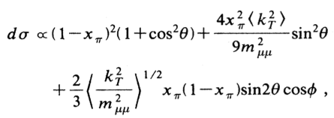

Parametrizing the Structure Function F_{π}.
Berger-Brodsky form had evolved over the intervening years:
  x dependence of second term had changed
  Additional angular dependence
E615 Fit function
(integrated over angles)
Higher twist term is significant

Slide 16
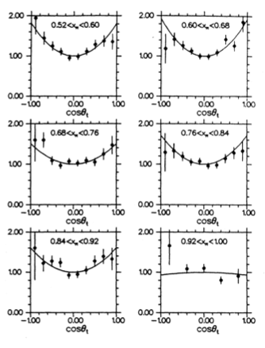
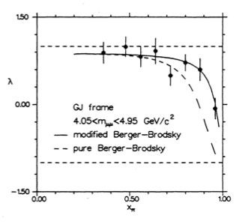
The Angular Distribution dσ/dcosθ.
Examine dσ/dcosθ in bins of x
  Low x: normal leading twist
  High x: higher twist?

Slide 17
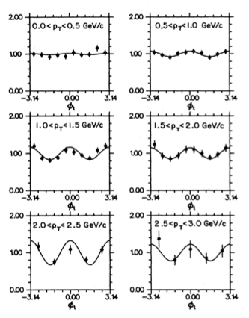
Many other topics studied
Phys Rev D 39, 92 (1989)
φ-dependence
K-factors
Scaling violation
p_{T} dependence
Nucleon structure functions
Different beam energies (s- dependence)

Slide 18
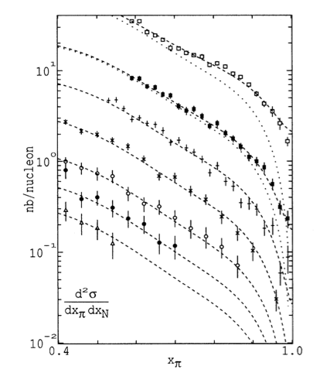
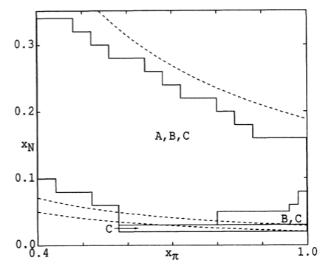
Lower mass, higher twist
Phys Rev D 44, 1909 (1991)
Higher twist fit
1991 paper explored higher twist effects further.
Push below charm resonances to get to M_{μμ} ~ 3 GeV
Leading twist only

Slide 19
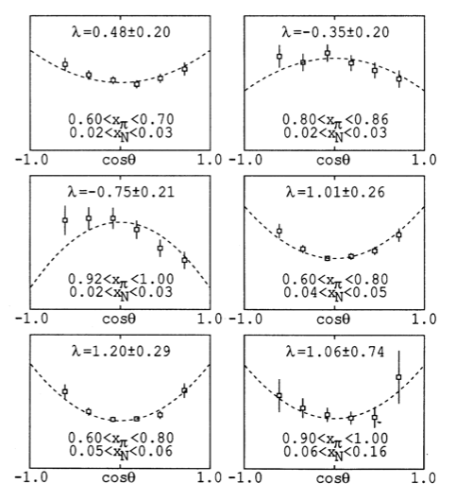
Fits to 1 + λcos²θ.
λ→-1 for high x_{π}, low x_{N}.
But BB form fits better when powers are “generalized”:
Results favor x²/m⁴.

Slide 20
The good old days…
A plethora of results about pion structure, especially at the extreme end of the quark momentum fraction distributions
Simpler conditions (in some ways… also more primitive!)
Wonderful people to work with
  Jim Pilcher, Kelby Anderson, Wyatt Merritt, Chris Adolphsen, John Conway, Joel Heinrich, Stu Smith, Frank Shoemaker, Kirk McDonald, Bill Louis, Sandro Palestini, Christina Biino, Eli Rosenberg
As a PhD student it was an unbeatable experience. The broad mix of tasks and the skills acquired is harder to offer these days. Special thanks to Jim and Kelby who set the standard for what it is to mentor one’s students and nurture the next generation.

Slide 21
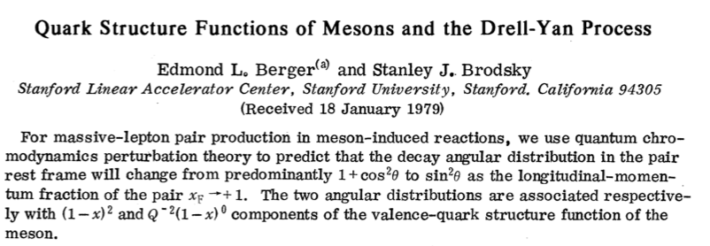

Slide 22
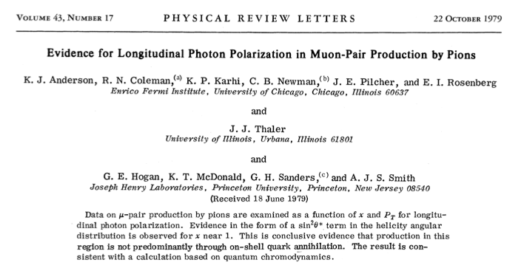

Slide 23
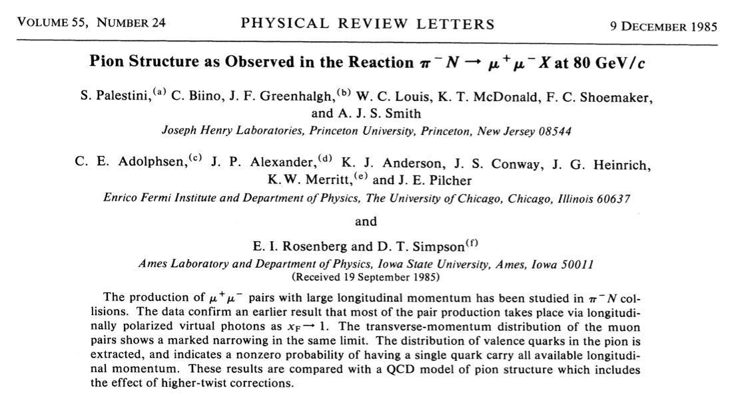

Slide 24
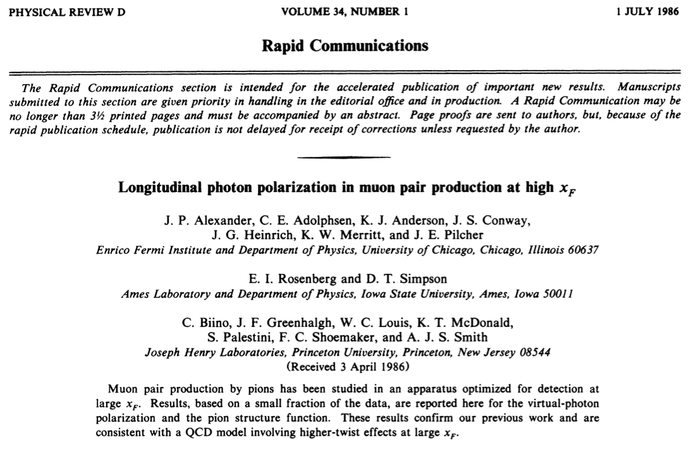

Slide 25
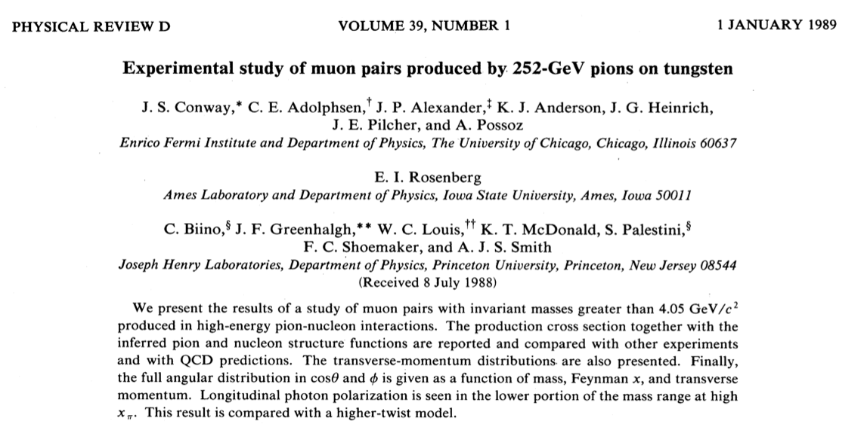

Slide 26
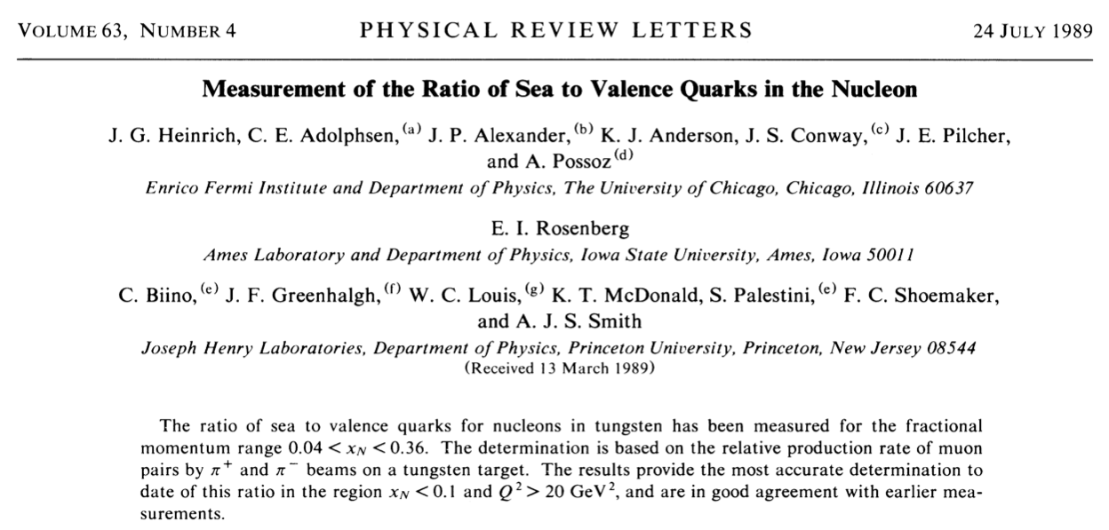

Slide 27
