Slide 1
The program today will be about the 3 main areas of
physics in Jim’s career at the University of Chicago
- The muon pair experiments at Fermilab
- The OPAL experiment at LEP (CERN)
- ATLAS at the LHC (CERN)
Before we start I want to mention some of the other
important work Jim has been involved in.

Slide 2
ANL 30” Bubble Chamber

Slide 3
Princeton-Penn Accelerator

Slide 4
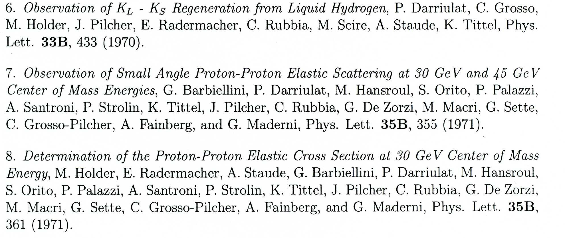
CERN PS
CERN ISR

Slide 5
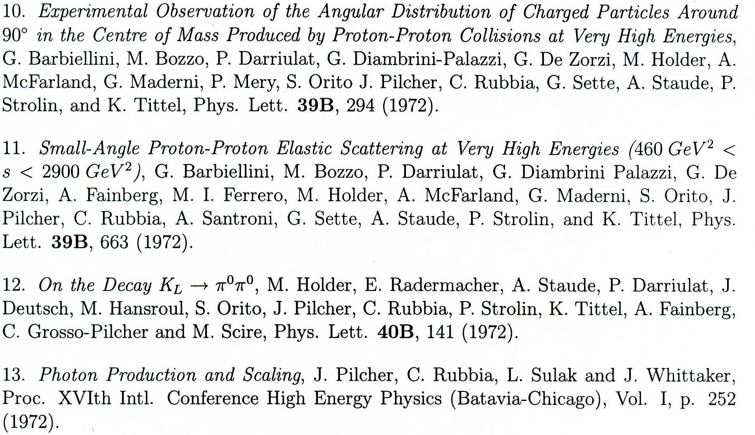
CERN ISR
CERN PS
ISR

Slide 6
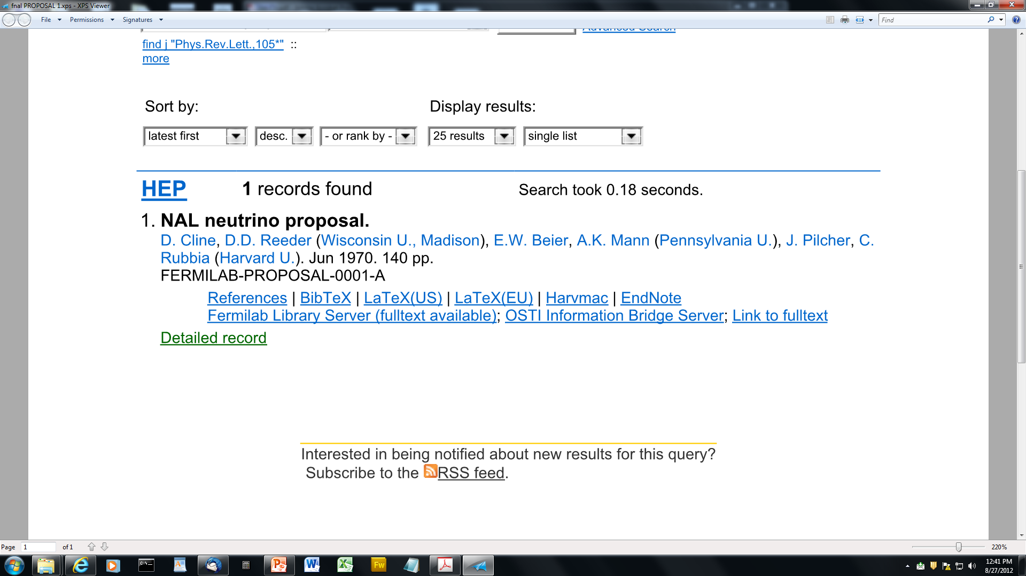
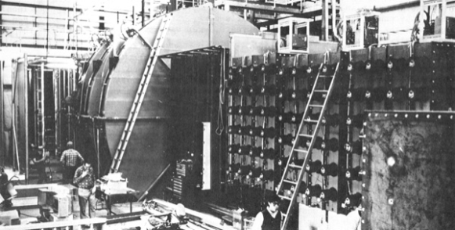
Jim is on Fermilab Proposal 1A

Slide 7
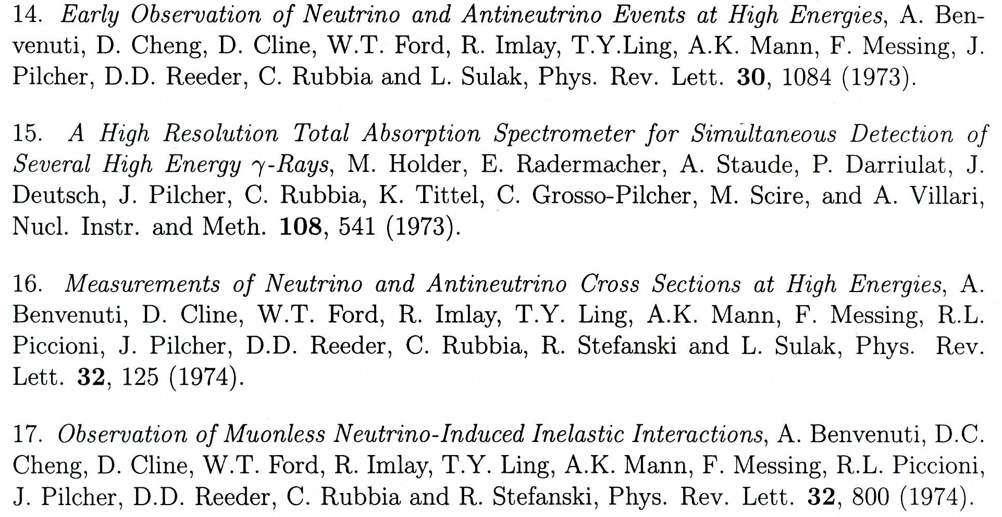
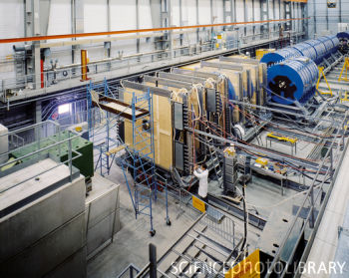
BCDMS Experiment
(structure functions)
deep inelastic muon scattering

Slide 9
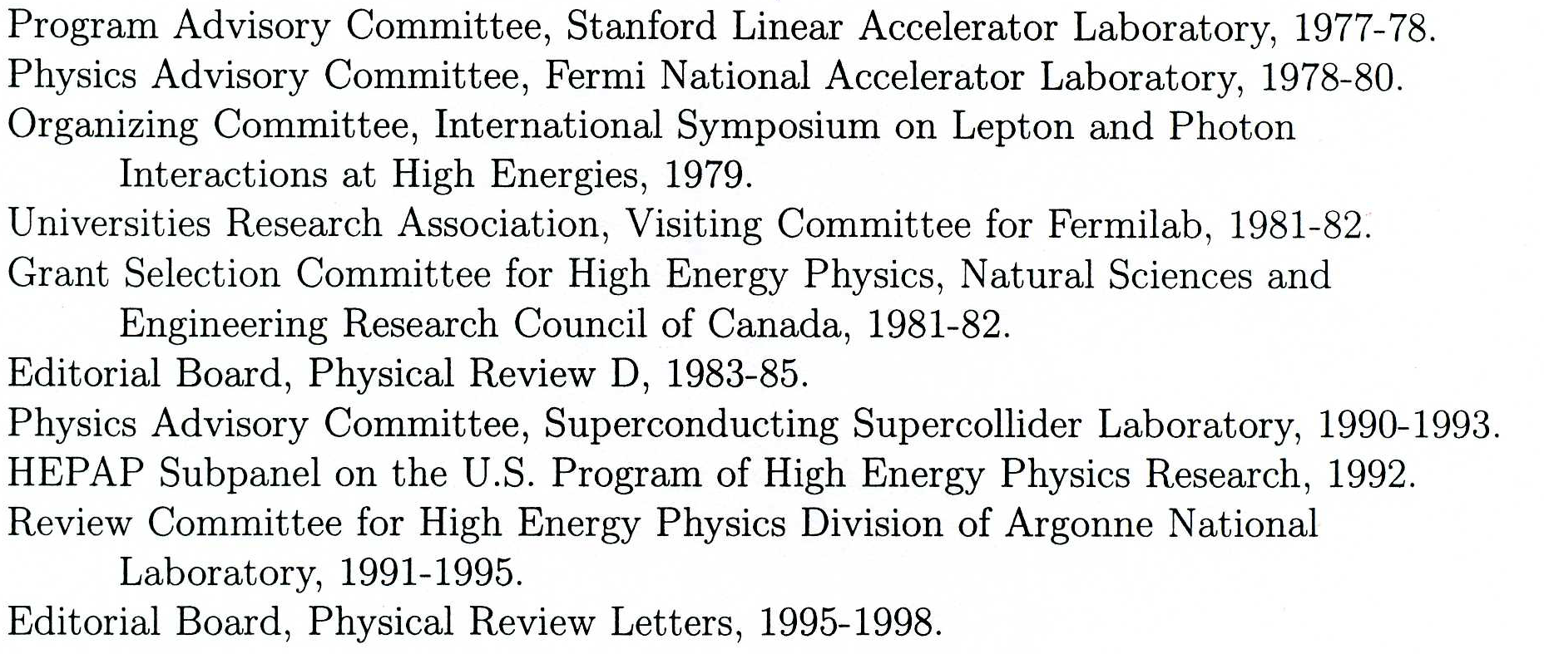
Director: Enrico Fermi Institute, University of Chicago (2001-2007)

Slide 10
This Session
Muon Pair Productions Experiments at FNAL
E331
E444
E615

