Slide 1
LEP/OPAL: 1985-2002
We build Presampler, Frontend electronics, and later electronics for the SiW luminometre
Notice to self: in the future don’t name a module “CIA”
10 Graduate students
13 Postdoctoral scholars

Slide 2
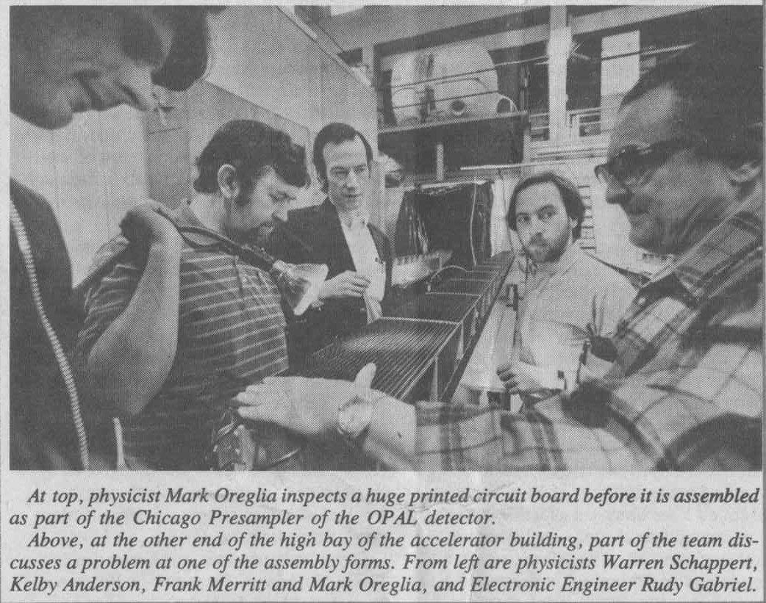
Ah, the old days…

