Slide 1
Commissioning Physics:
A story of building the TileCal and becoming part of a community
David W. Miller
The University of Chicago, Enrico Fermi Institute

Slide 2
Why “commissioning physics”?
In order to understand the title of this talk, I need to walk you through the story of what I have learned directly or indirectly from Jim Pilcher.
  To start with, I need to tell you why Jim is, in a very real sense, the reason that I am in High Energy Physics today.
  How Jim’s guidance in helping to build the Tile Calorimeter shaped my understanding of High Energy Physics
  What physics interests those experiences have led to, and, ultimately, why I have found myself back at the University of Chicago

Slide 3
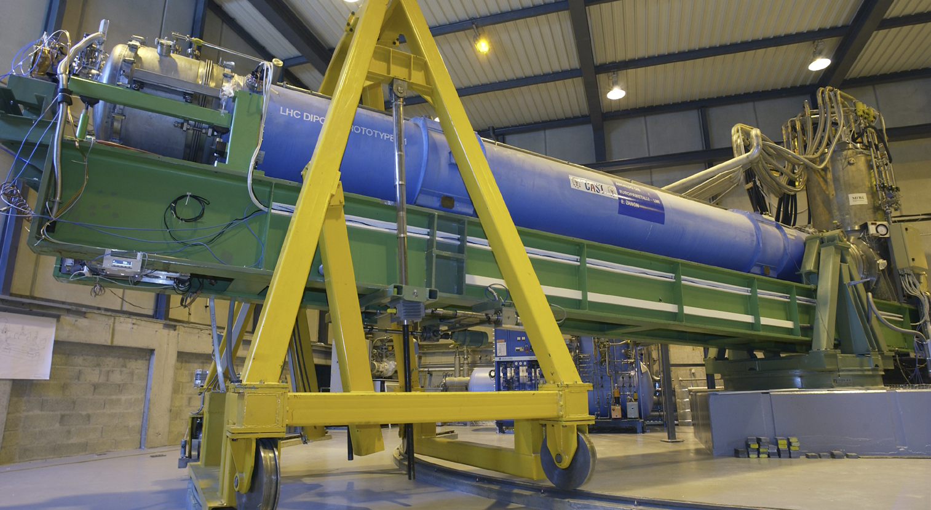

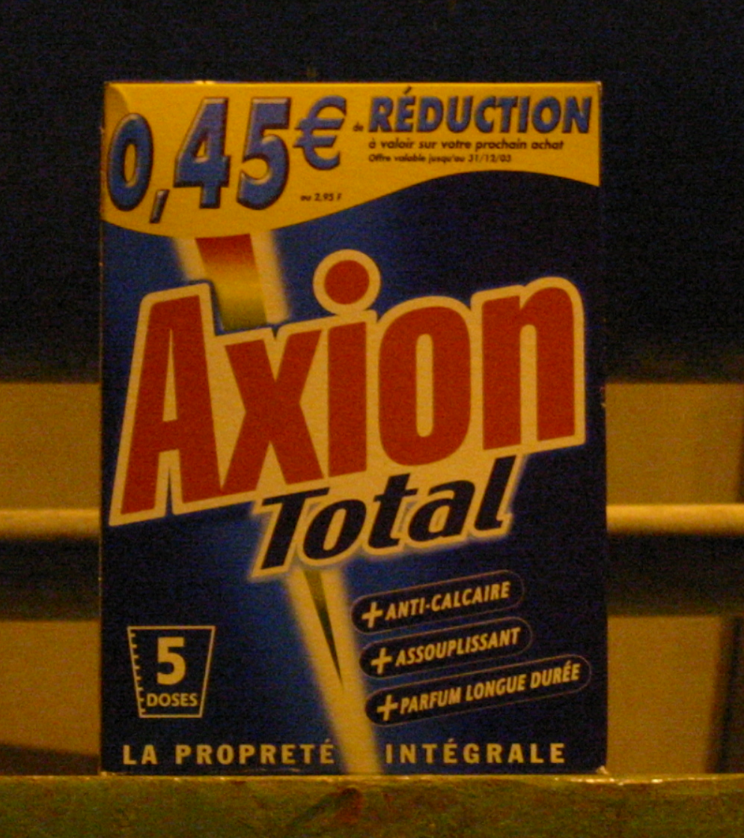
A bit of history
Astroparticle physics and the CAST Experiment were what ushered me into experimental physics in 2002
During my time spent at CERN, I learned that particle physicists weren’t really as bad as the astrophysicists said they were

Slide 4
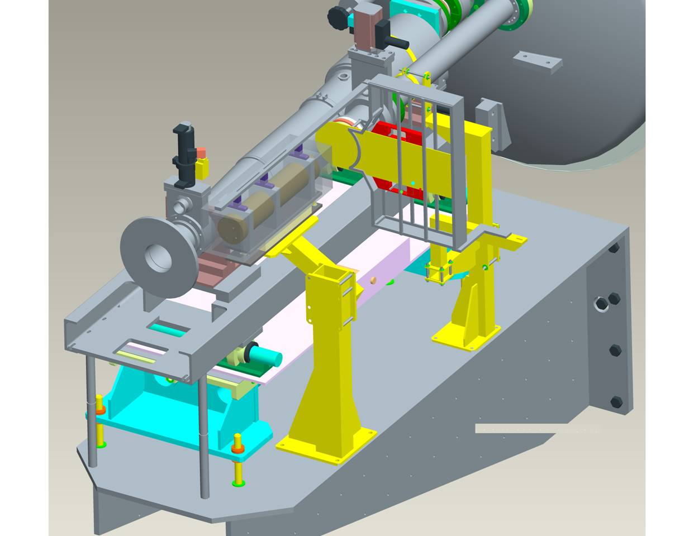
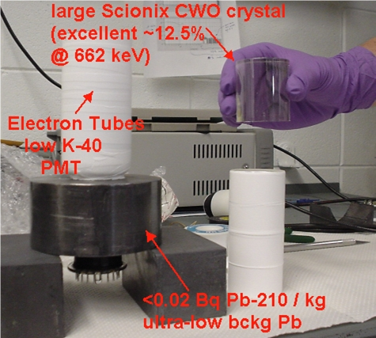
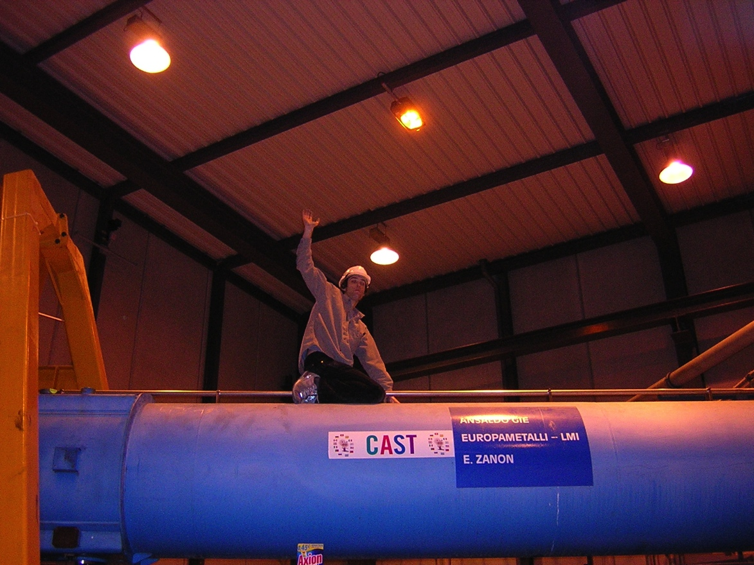
The CAST Calorimeter

Slide 5
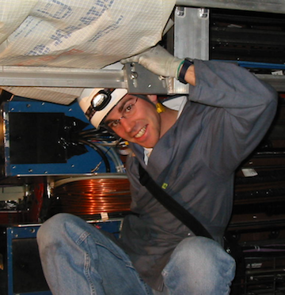
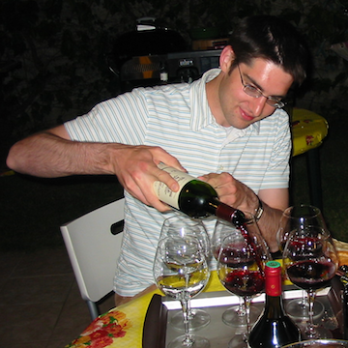
The beginning of what would become Jim’s army of not-yet-physicists
During the spring of 2005, I received an email from Jim asking if I would like to participate in the construction and commissioning of the Tile Calorimeter at CERN for 1 year
  I jumped at the opportunity
  As did David Lawlor
David Lawlor
“The Two Davids”

Slide 6
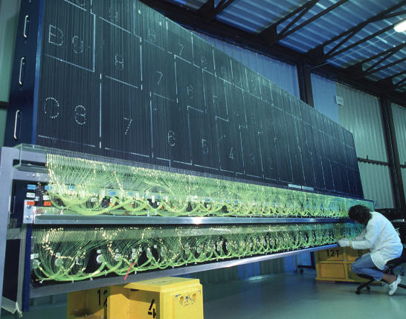
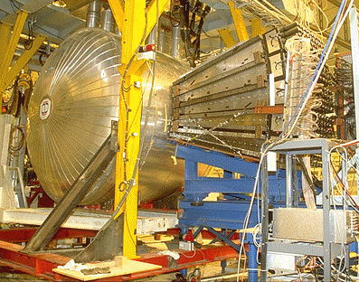
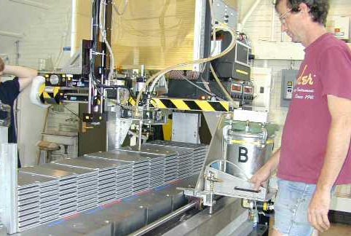
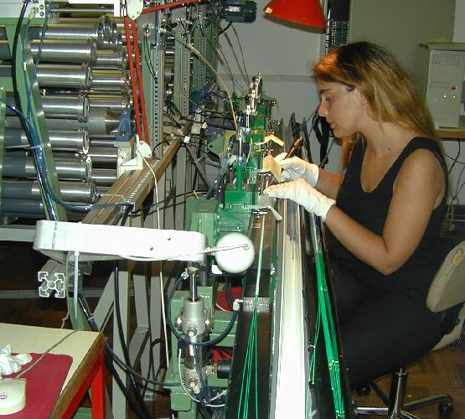
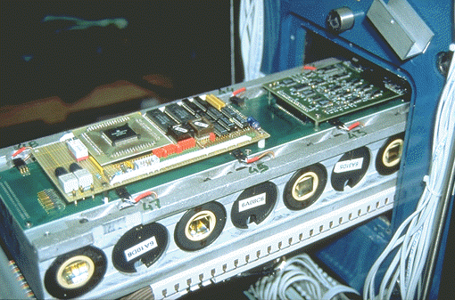
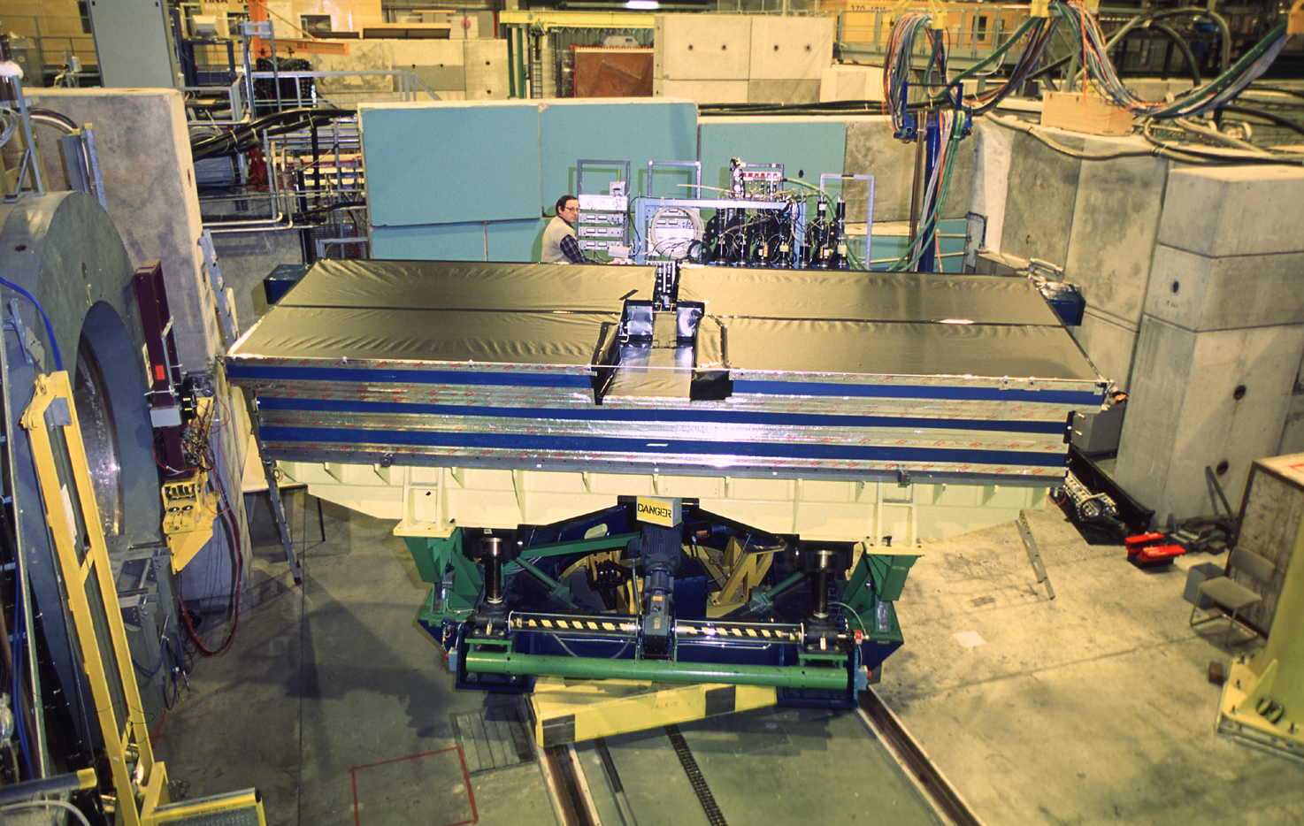
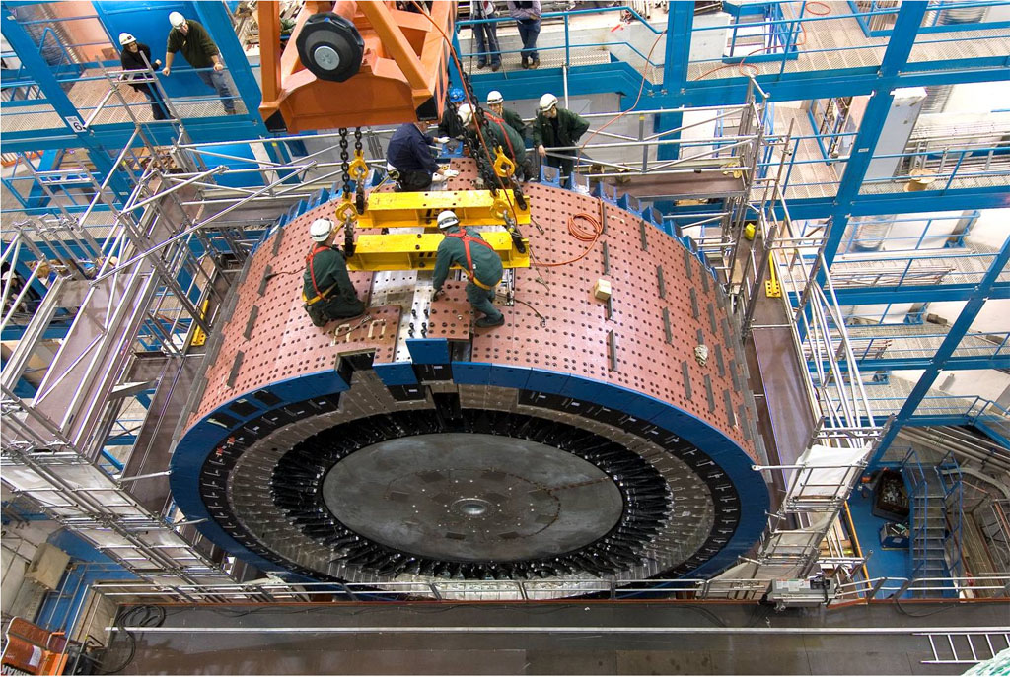
Constructing and commissioning the Tile Calorimeter
’93-’95: R&D
’96-’02: Mechanics & Optics Construction
’99-’02: Instrumentation
’99-’04: Electronics
’02-’04: Test beams
’04-’06: Commissioning

Slide 7
Constructing and commissioning the Tile Calorimeter
’93-’95: R&D
’96-’02: Mechanics & Optics Construction
’99-’02: Instrumentation
’99-’04: Electronics
’02-’04: Test beams
’04-’06: Commissioning

Slide 8
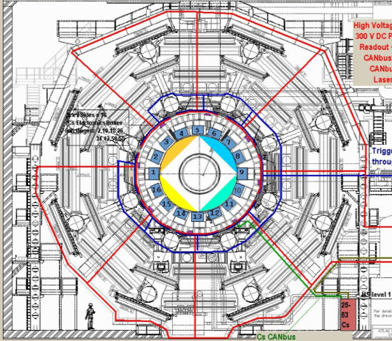
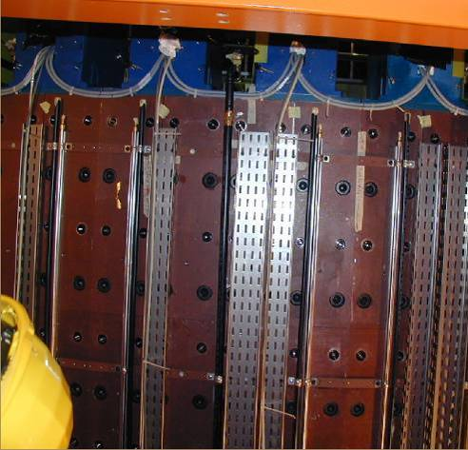
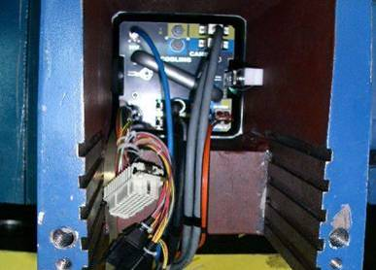
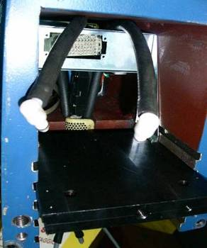
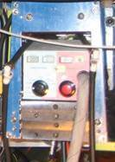
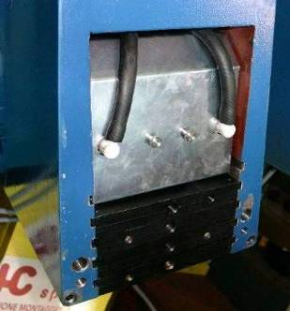
TileCal Commissioning Campaign

Slide 9
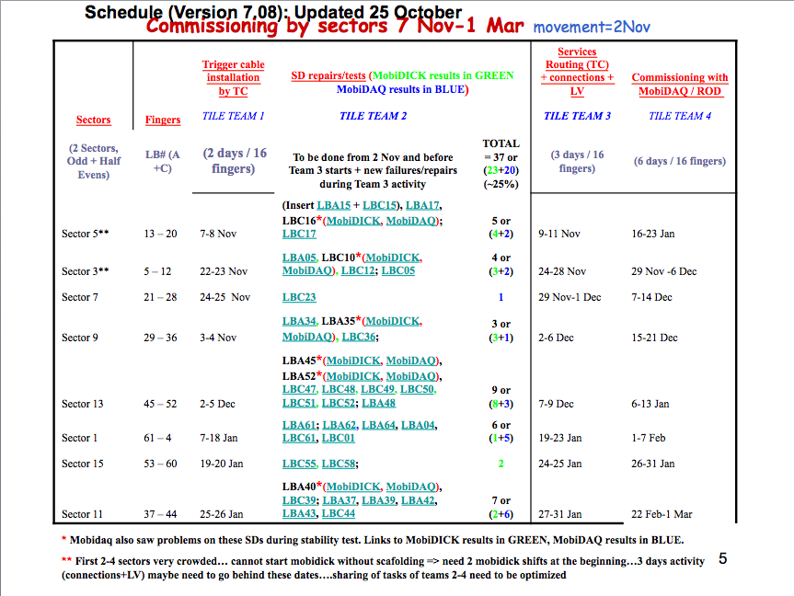
The Commissioning “Teams”
+ Team 5!
Data Quality and Performance
-Bob Stanek, Oct. 2005

Slide 10
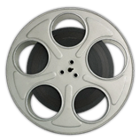
What it means to be an “expert”
As the plans for commissioning were coming together, Jim encouraged us to make sure we were involved and integrated into the work.
He provided one piece of advice that I will never forget.
"Experts are those who get involved enough to learn what is going on”

Slide 11
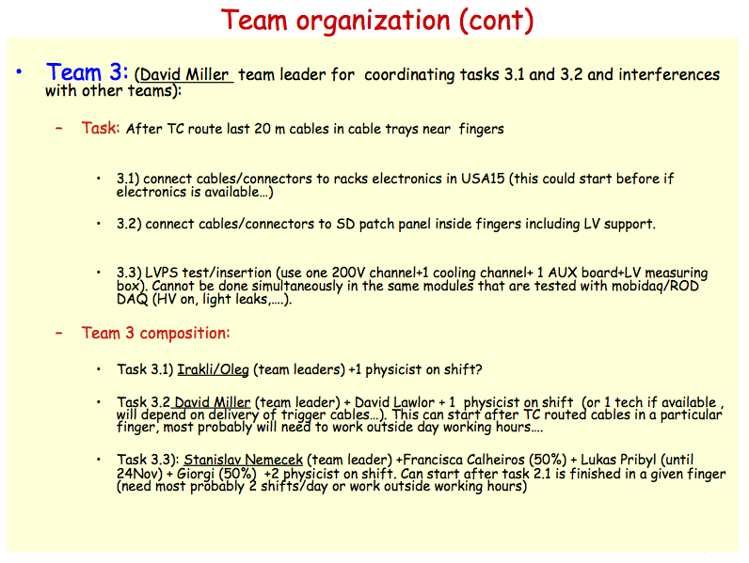
Front-end electronics connections and commissioning team

Slide 12
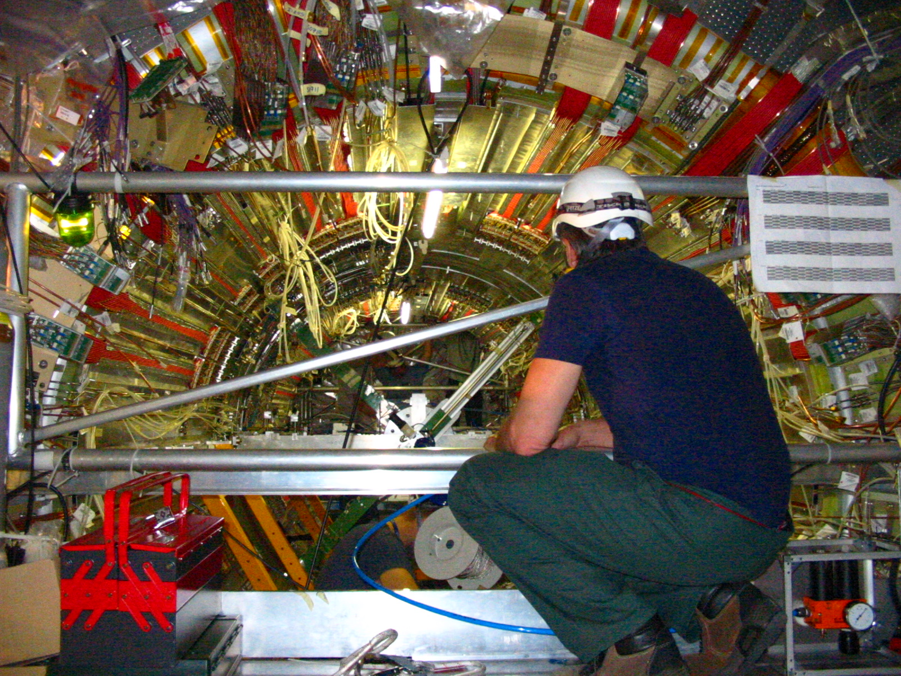
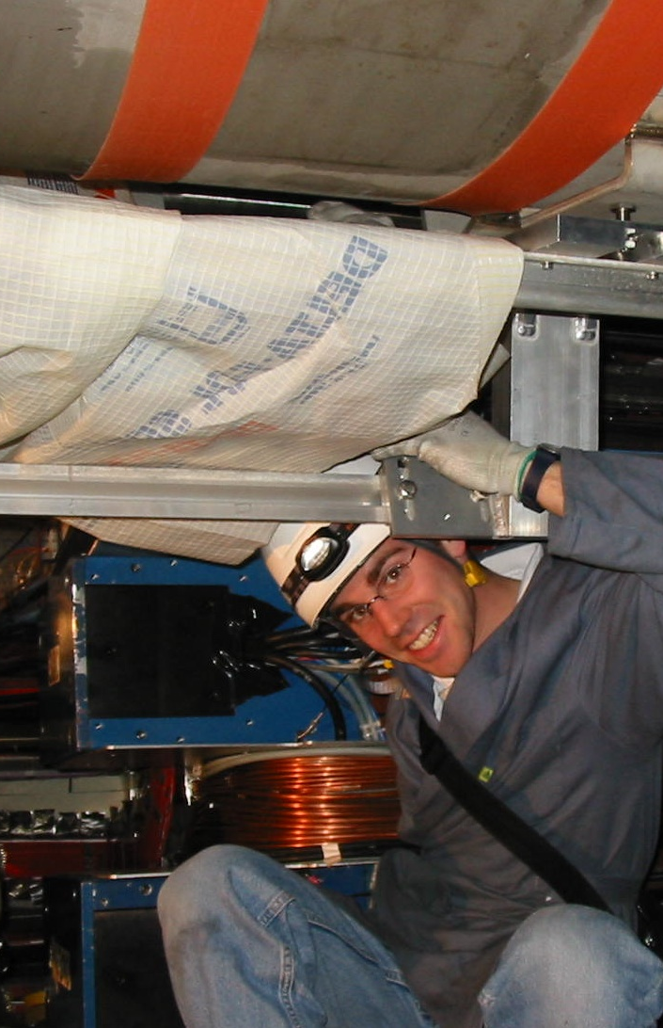
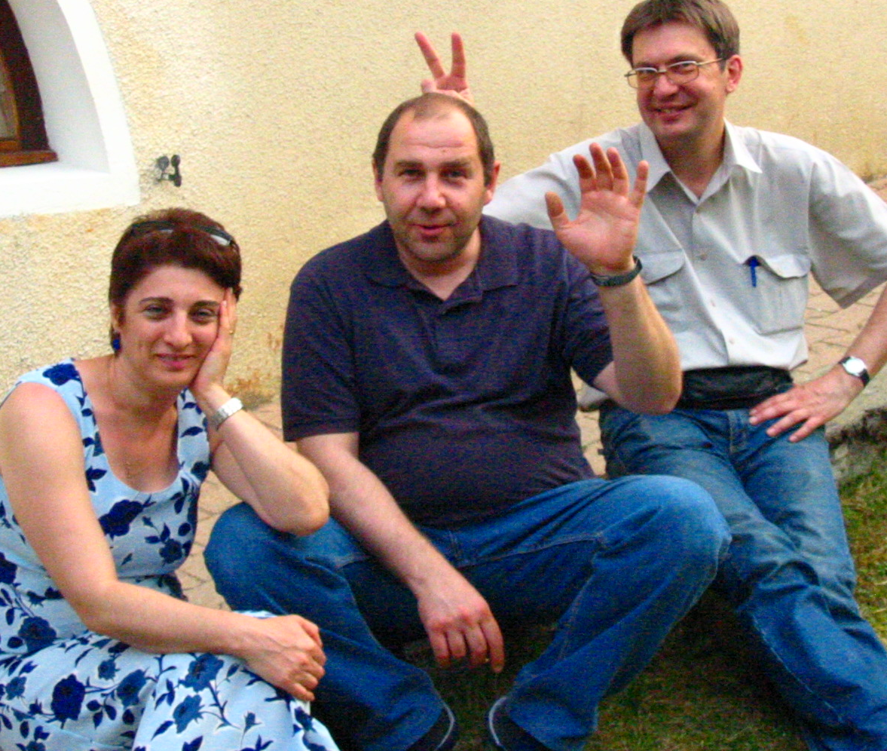
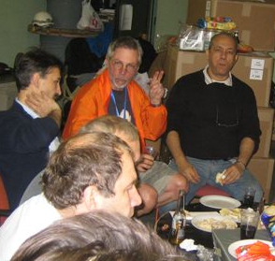
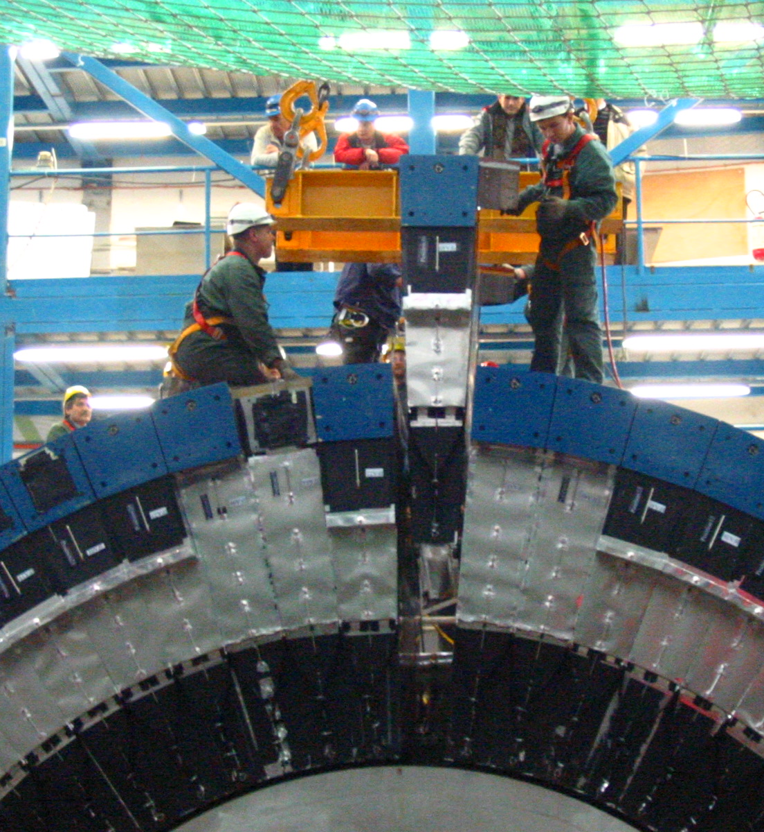
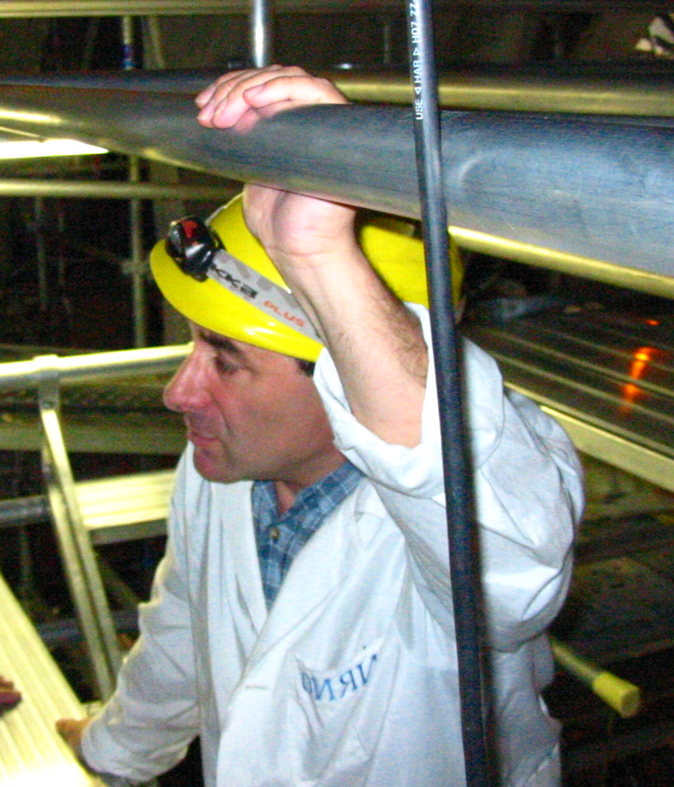
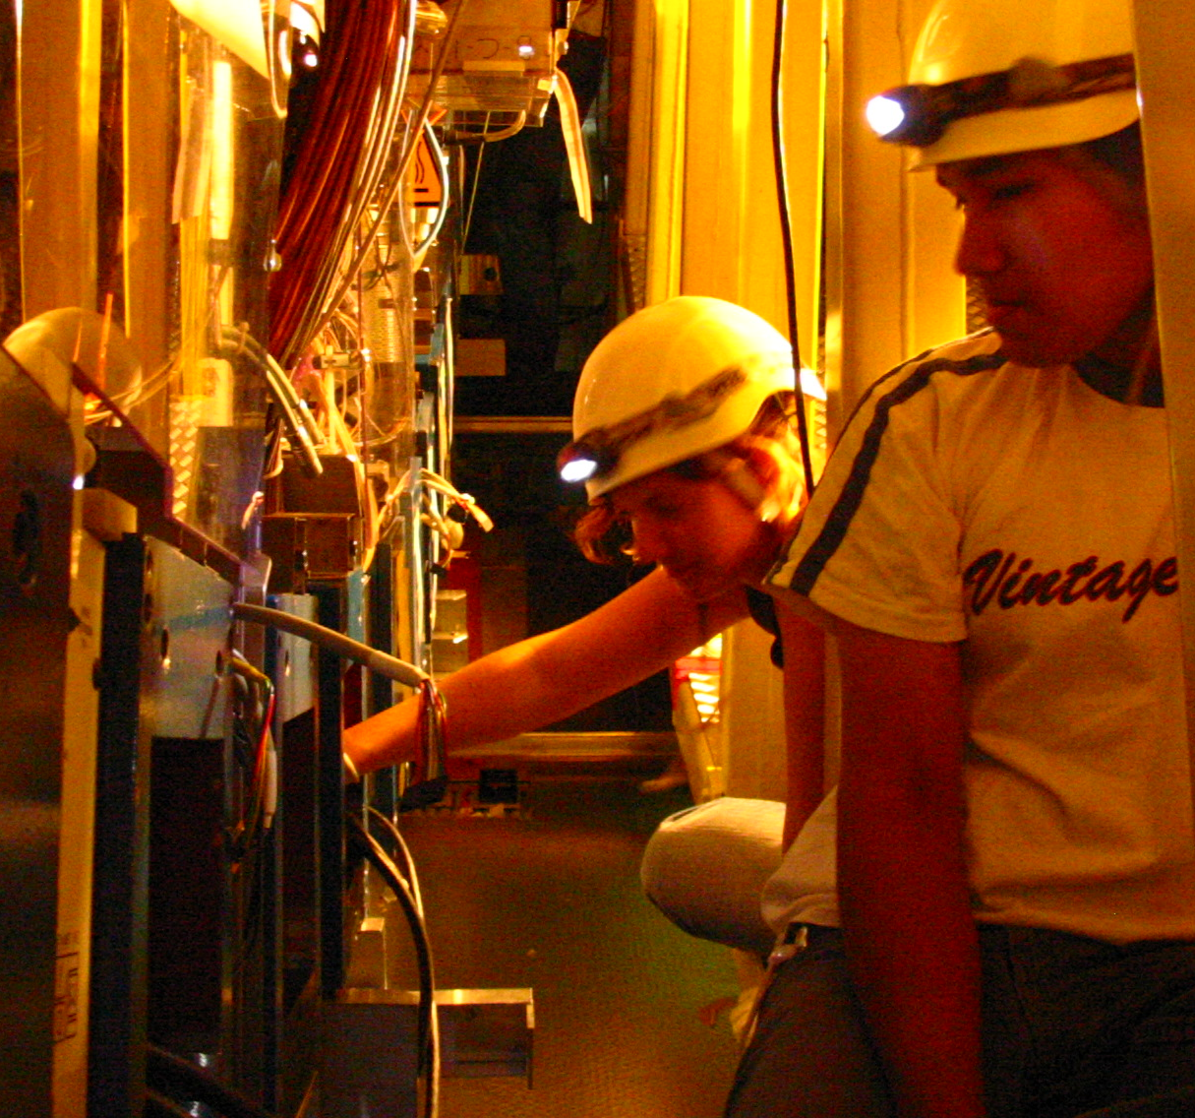
With this advice, we became heavily involved, and even helped to shape the commissioning of the ATLAS TileCal.

Slide 13
Not “just” a calorimeter
During this period it was easy to drift into thinking of ATLAS as many disparate pieces, each separate from one another, with different teams and different approaches.
Jim did not let us forget that the whole would – eventually – be greater than the sum of its parts.
“You'll be surprised at how much one part of the detector will teach you about another.”

Slide 14
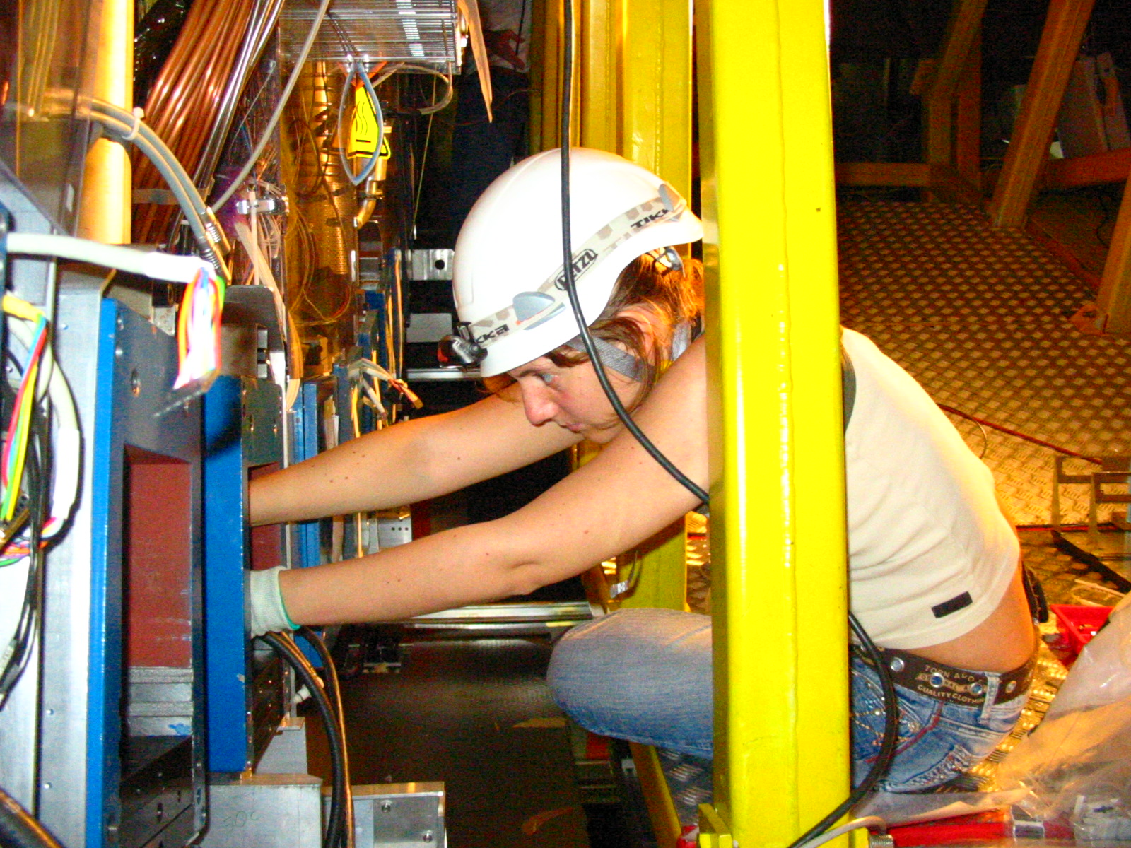
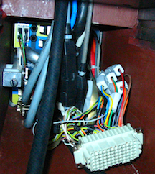
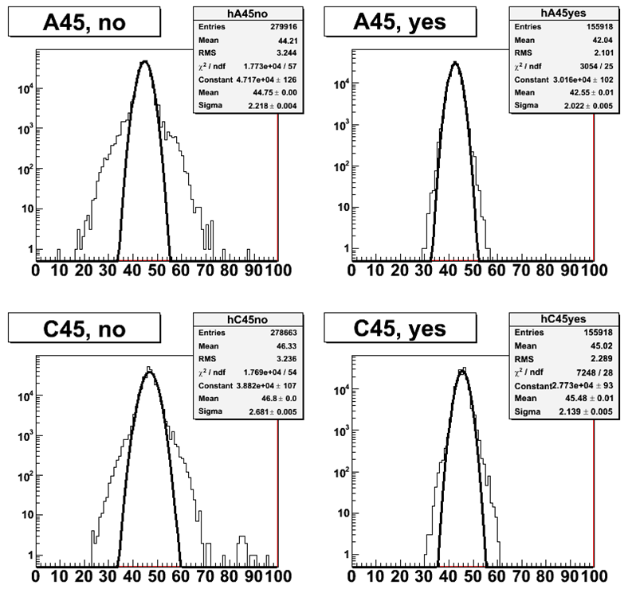
“How do we build the best instrument to do the best physics?”

Slide 15
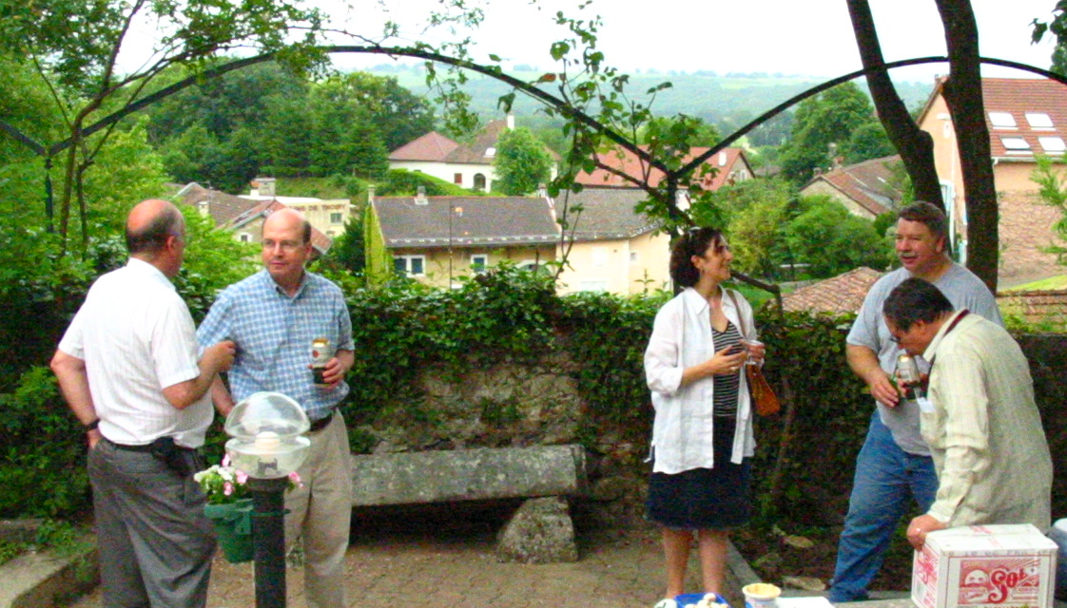
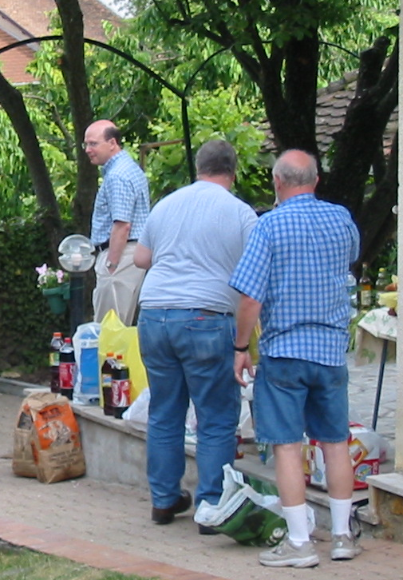
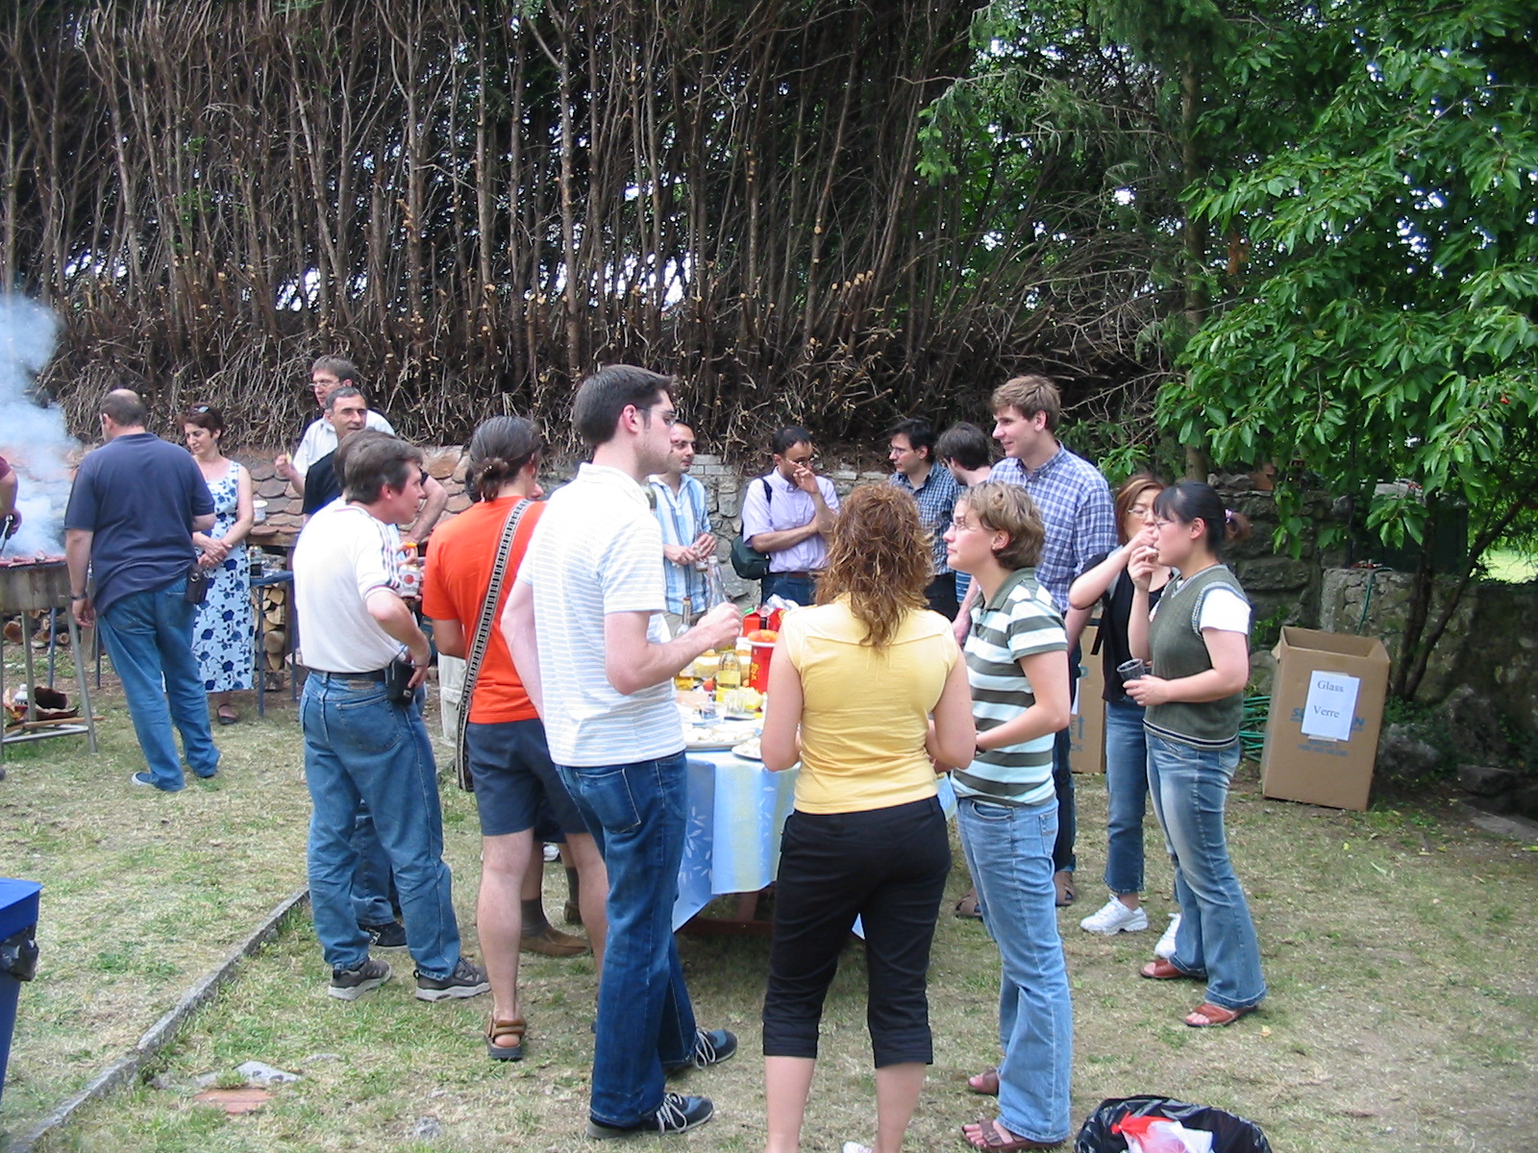
And physics is not done in a vaccum
End of year BBQ at Larry Price’s house

Slide 16
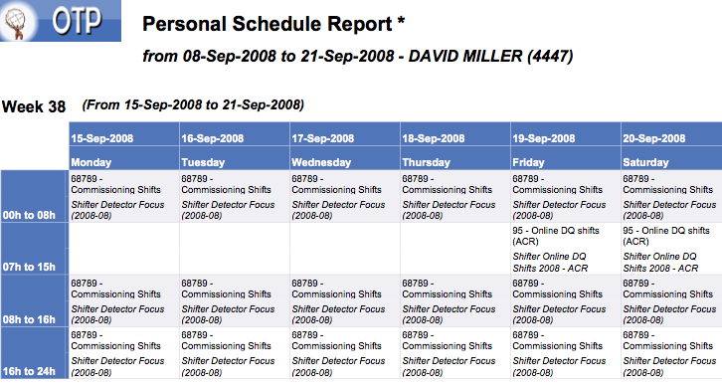
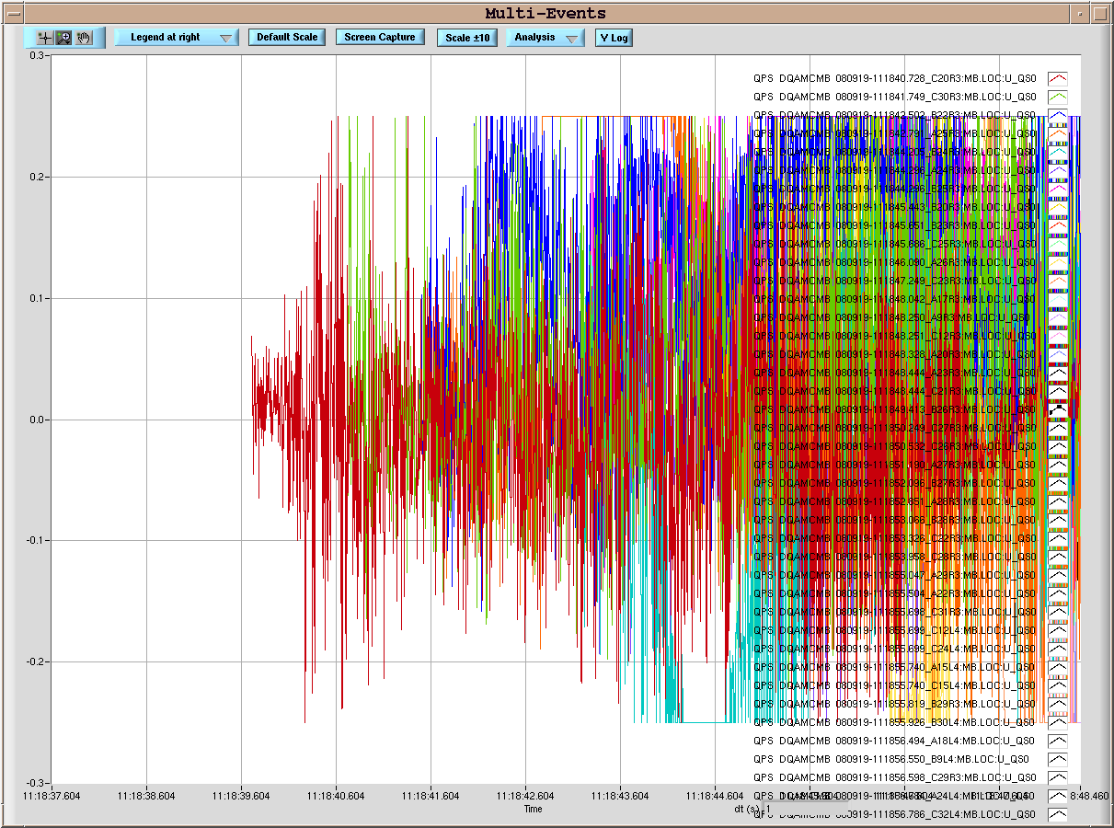
And then, the unthinkable happened
An unfortunate shift, but a little extra time!
From the LHC Logbook

Slide 17
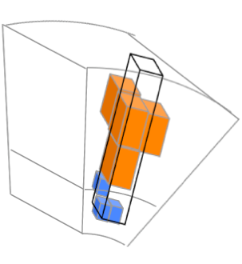
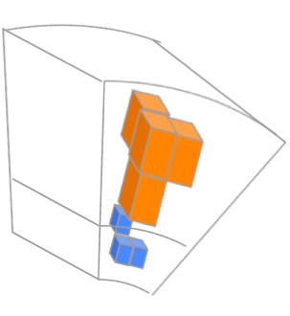
Continue with the foundations of jet physics
Fundamentals of jet algorithms
Understand pile-up and offset corrections
Establish in-situ techniques for JES validation
New jet reconstruction techniques
topotowers
tracks
clusters

Slide 18
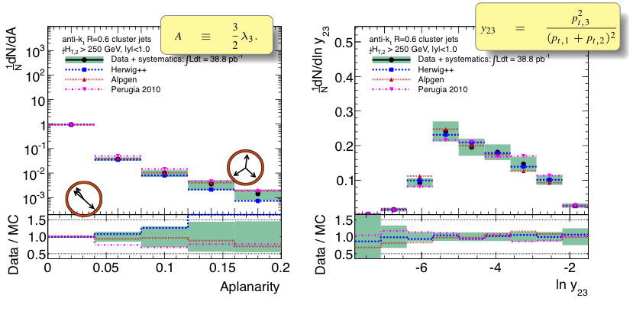
Hadronic event shape measurement
Classic Standard Model measurement…pioneered at SLAC and provided the first evidence of the existence of jets!

Slide 19
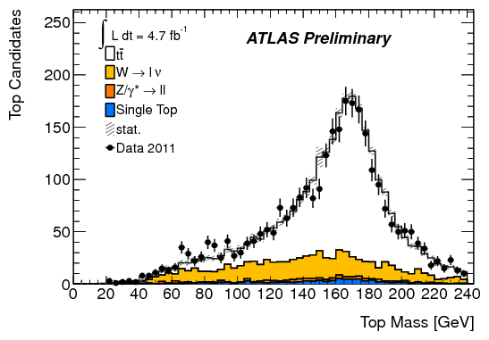
All roads lead to Chicago:
Searches for new physics in hadronic final states, under Jim’s guidance once again
Top mass peak using jet boosted
substructure techniques
Limits on Supersymmetry using hadronic
final states (and substructure!)

Slide 20
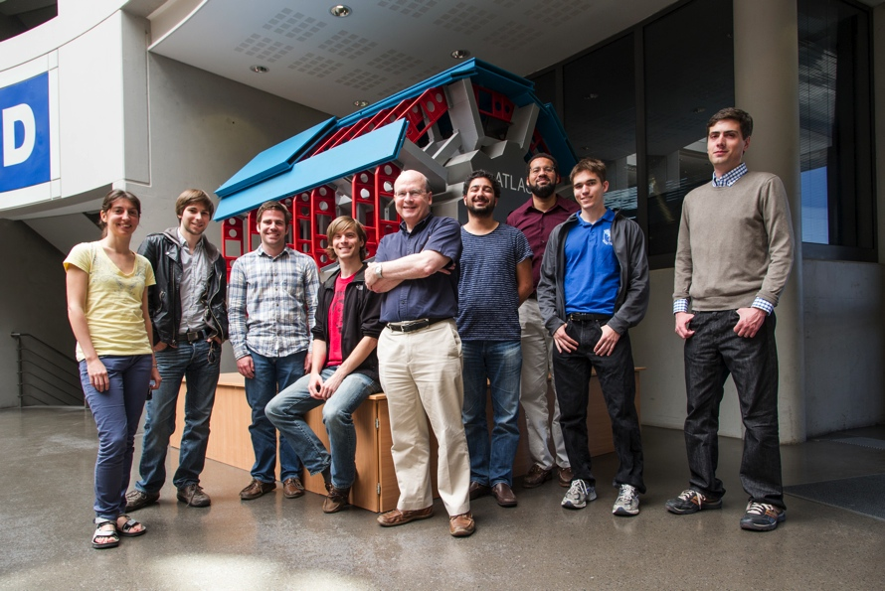
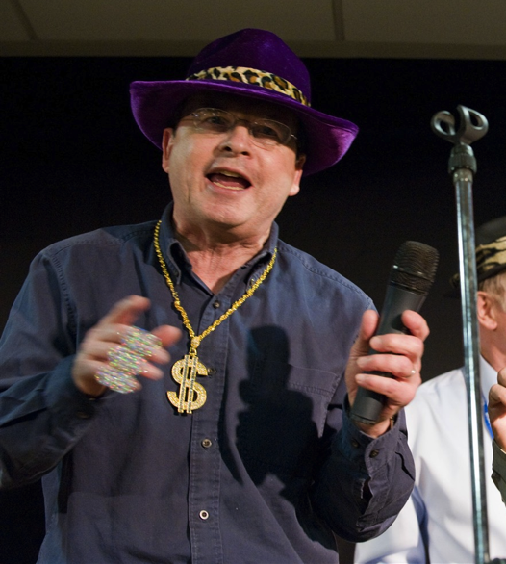
Congratulations, Jim!

