Slide 1
Fun with the Chicago Cylotron: μ-pair production in hadronic collisions Stewart Smith Princeton University s
Symposium to honour our great friend and colleague Jim Pilcher on his retirement
September 22, 2012

Slide 2
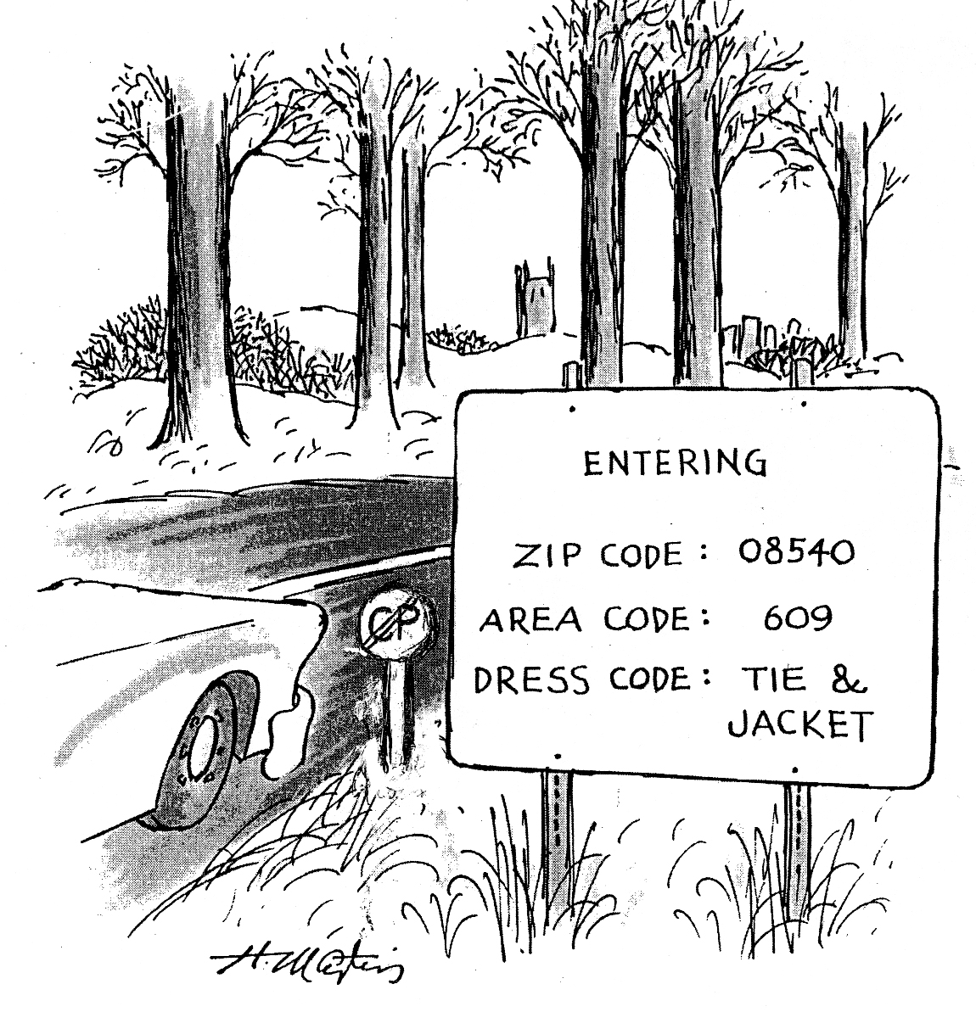
September
1965

Slide 3
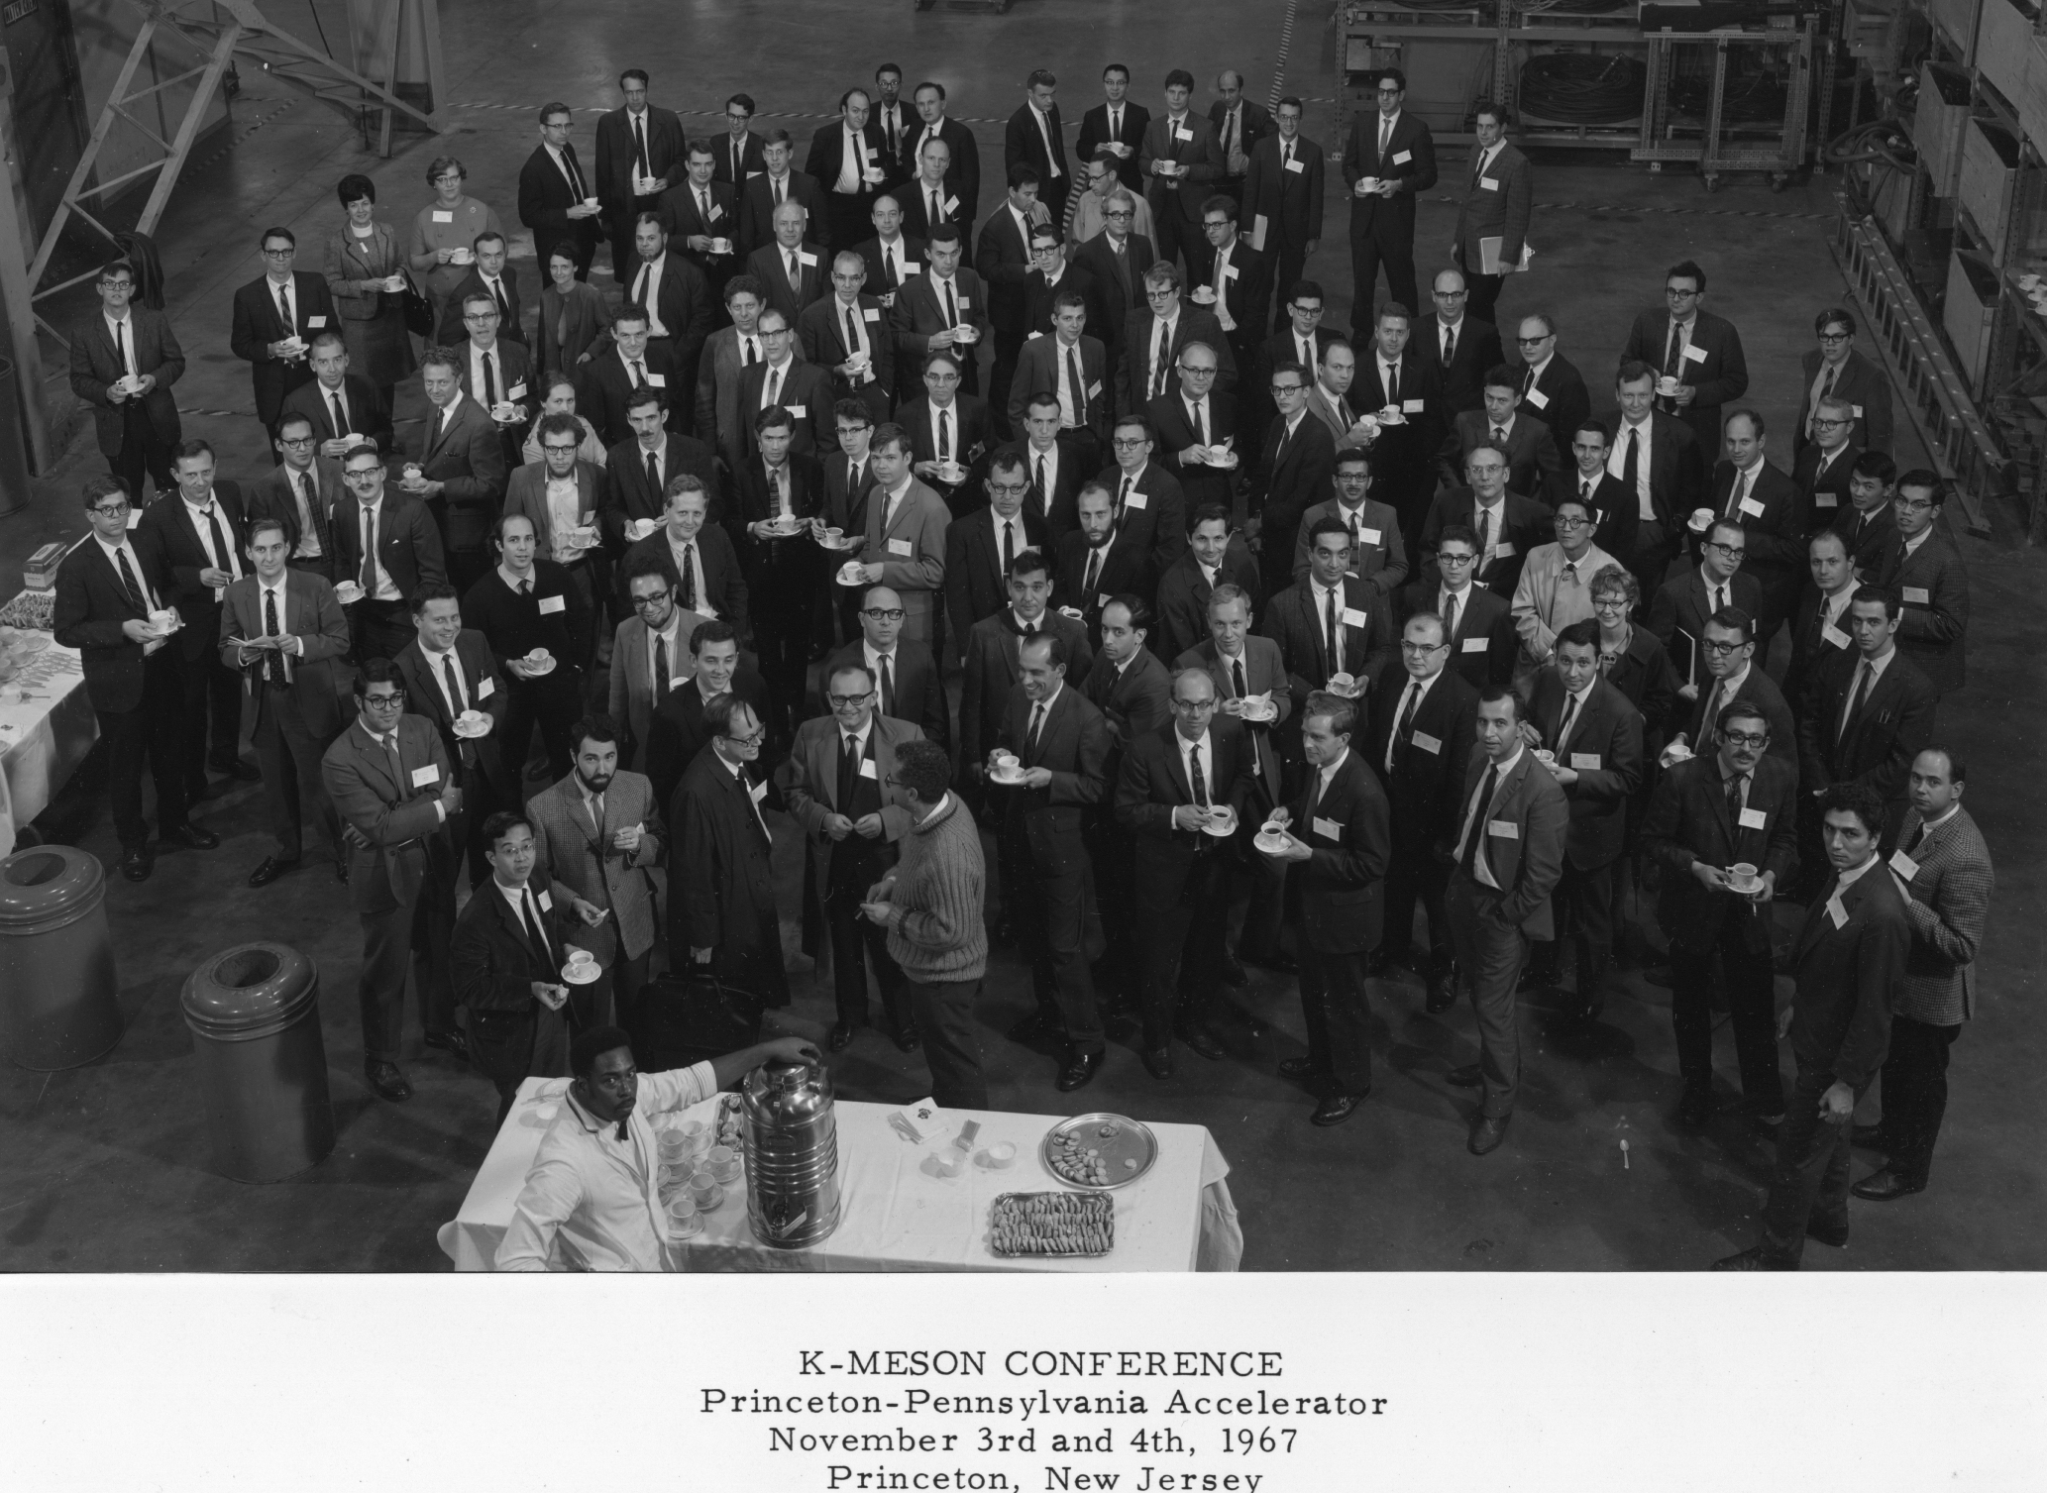

Slide 4
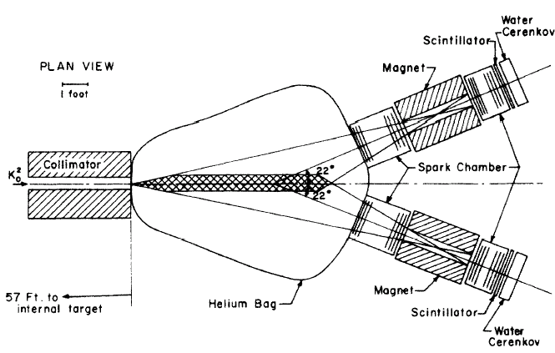
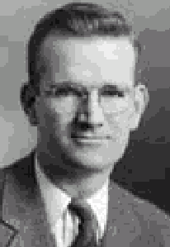
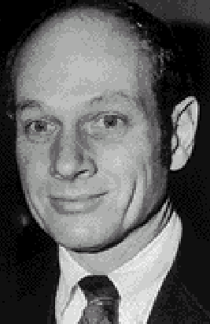
The Discovery of CP violation (1964)
K_{L} → π⁺π⁻
CP = -1 CP = +1
~ 0.2% of the time
Completely unexpected!
Didn’t fit any existing picture.
New Forces at work?

Slide 5
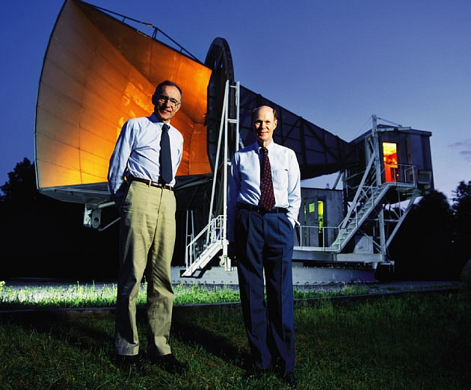
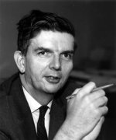
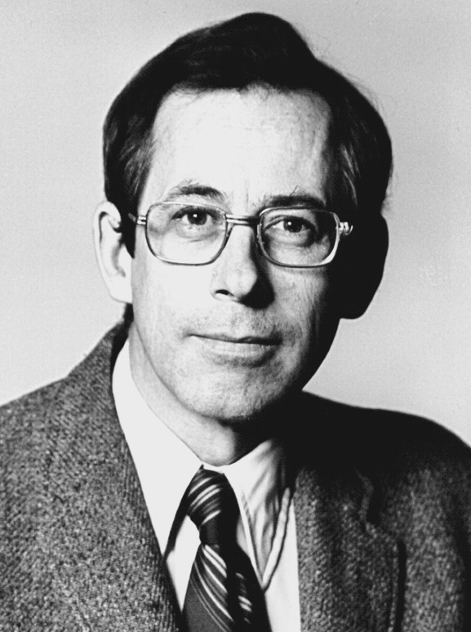
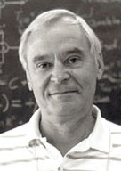
CMB discovery, explained as evidence of the Big Bang

Slide 6
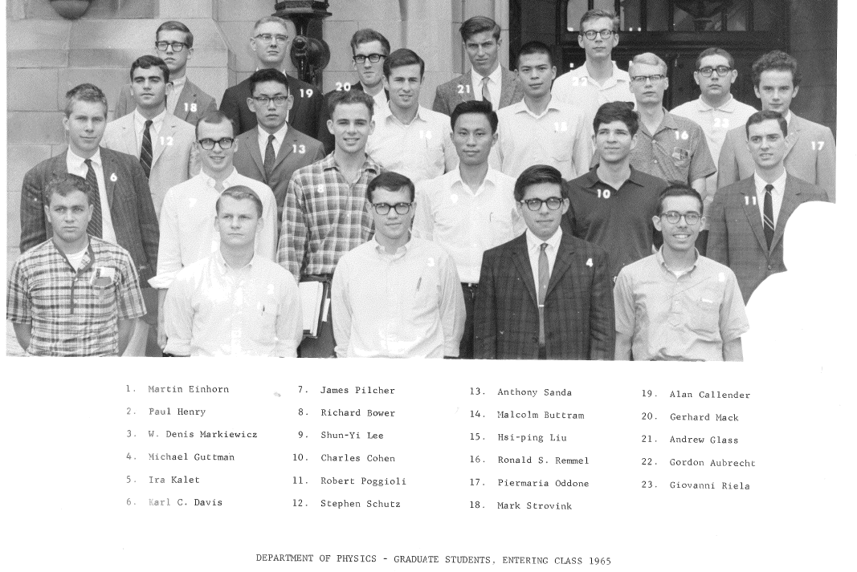
Entering Grad Class -- 1965

Slide 7
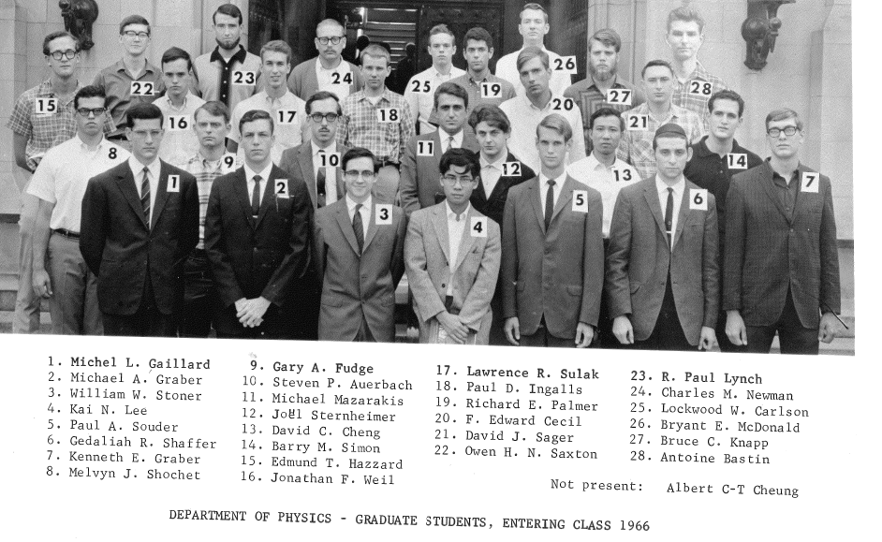
Entering Grad Class -- 1966

Slide 8
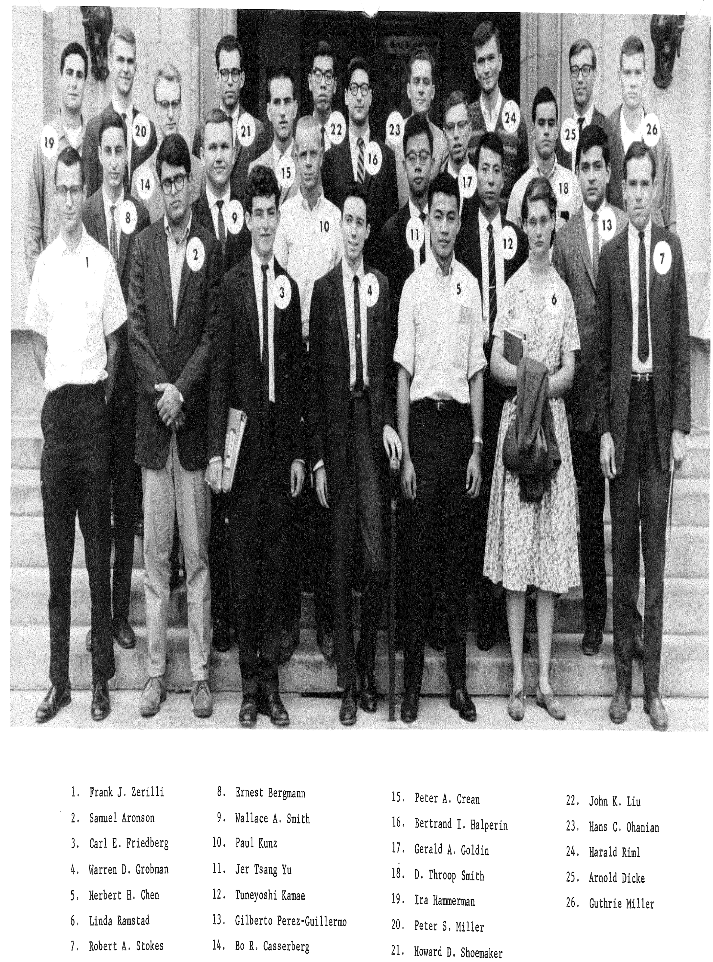
Entering Grad Class -- 1964

Slide 9
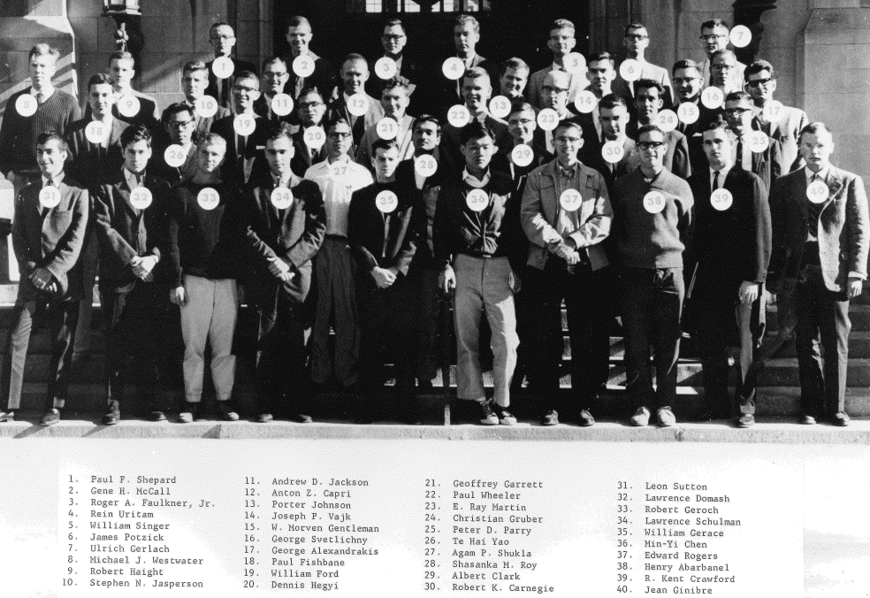
Entering Grad Class -- 1963

Slide 10
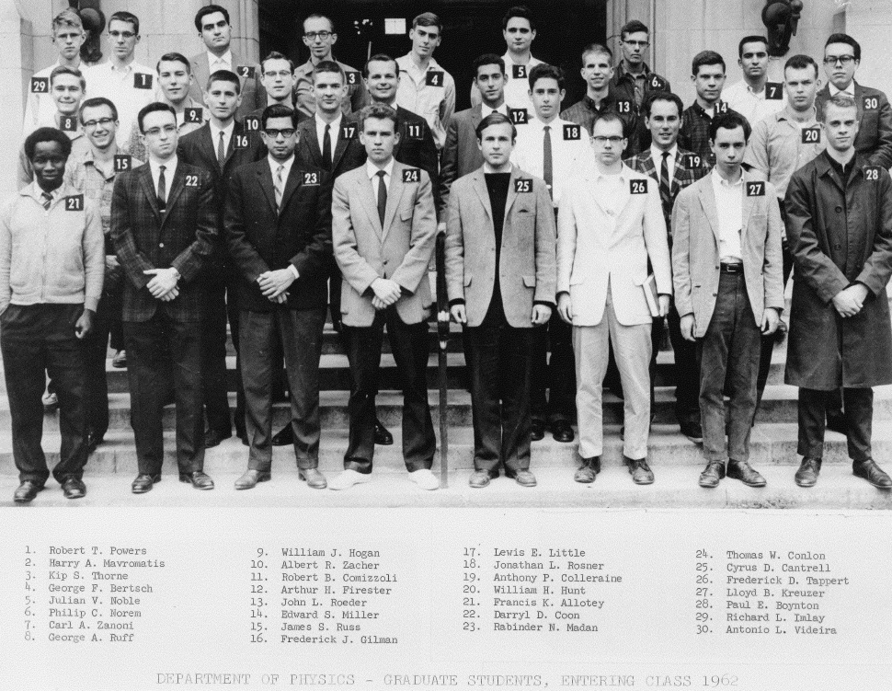
Entering Grad Class -- 1962

Slide 11
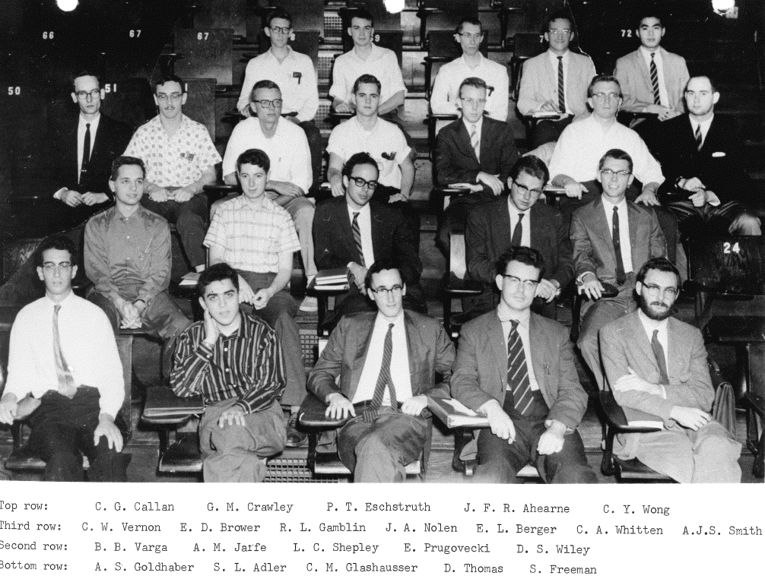
Entering Grad Class -- 1961

Slide 12
Lots of Jim’s contemporaries who worked on K-decay went on to careers in HEP
Jim Christenson (Columbia-NYU-Fermilab)
Wayne Vernon (UC San Diego)
Richard Imlay (Wisconsin – LSU)
Bob Carnegie (SLAC - Carleton Univ)
Jim Russ (Carnegie Mellon)
Bill Ford (Penn – Colorado)
Paul Kunz (SLAC)
Jim Pilcher (CERN – Chicago)
Mark Strovink (Princeton – UC Berkeley)
Mel Shochet (Chicago)
Bruce Knapp (Columbia)
Paul Souder (Yale – Syracuse)
Larry Sulak (CERN-Harvard-BU)
Robert Webb (Princeton-Texas A&M)

Slide 13
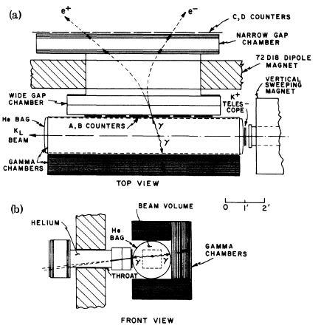
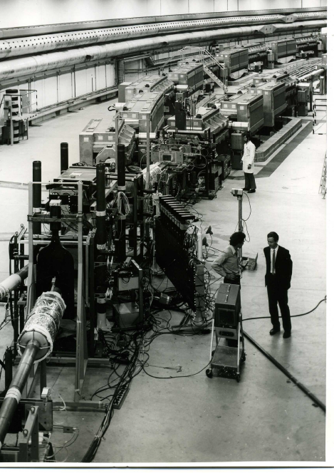
K_{L}→γγ = (4.68 ±0.64) × 10⁻⁴
|η⁰⁰| = ( 2.3 ± 0.3) × 10⁻³ ≈ |η⁺⁻|

Slide 14
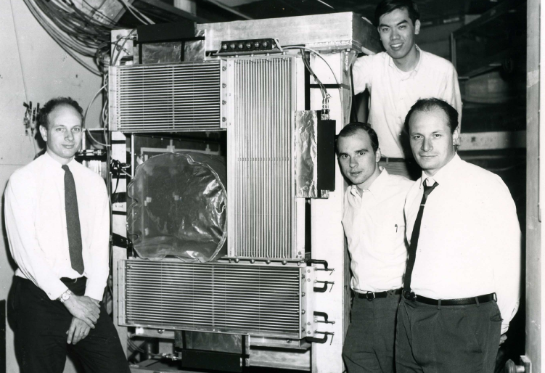
The Gang of Four ~ 1968

Slide 15
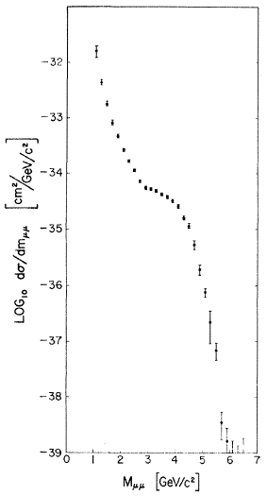
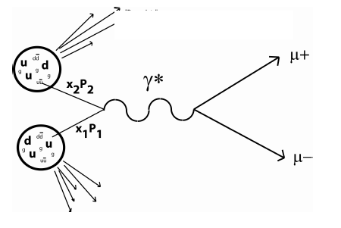
Beginning of lepton-pair physics
Christenson
et al
1970
Drell Yan 1970
Function of τ = s/M² only, not simply of s
D-Y does not explain shoulder,
but starts a new field

Slide 16
Leptomania: 1971 -1976
Following the Columbia μ-pair discovery every lab received proposals for high-mass pair spectrometers, and experiments were soon under construction to turn on in 1974 - 5.
In the meantime a set of “beam survey-like” experiments (inclusive production spectra) were readying for the turn-on of NAL, ISR, Serphukov, …
e.g. a Princeton group (Cronin-Piroué) proposed an experiment to search for inclusive high P_{T} hadrons and leptons at 90° CM, where “nothing” was expected…. Cronin then moved to U Chicagoa in 1971, creating the “CP,” later “CP - I” collaboration.

Slide 17
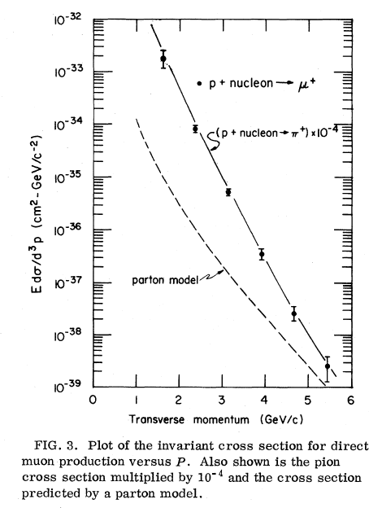
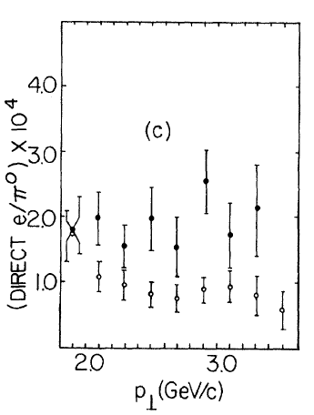
Two Big Surprises in
1974 !
Hadron flux was very large, measurable out to > 5 GeV/c.
A “prompt” muon flux tracks the hadrons at a factor 10 ⁻⁴
Much too high to come from known sources.
Chicago – Princeton
Columbia -- Fermilab

Slide 18
Jim was right in the midst of the action!

Slide 19
Where were these leptons coming from?
New particles, e.g. charm, decaying semi-leptonically?
New vector mesons decaying to lepton pairs?
Some new electromagnetic source?
a
Ferment at London ICHEP 1974
Neutral current discovery was the star of the show.
Leptomania intensifies: Lederman said pair spectrometers were the answer and would take a year or so.
Bizarre results from SPEAR: R is much larger than predicted by 3-quark model, and fluctuates wildly with s.
a
John Illiopoulos bets a case of wine charm
will be discovered before the 1976 ICHEP!

Slide 20
The path to the muon lab
Jim spent early 1974 thinking of experiments to see if pairs could account for the mysterious single inclusive lepton yield, and to test Drell-Yan.
Large acceptance and high mass resolution were essential.
He and Kelby focused on the feasibility of the Chicago-Cyclotron FACILITY, built for μ-scattering expt’s.
And then the J/ψ was discovered in November!
A couple of weeks later, Jim gave me a call out of the blue, and so the “CP – II” collaboration was born:

Slide 21
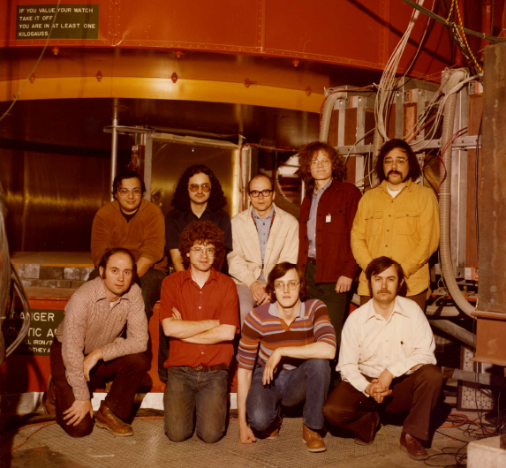

Slide 22
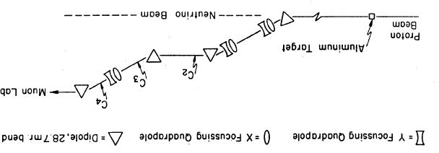
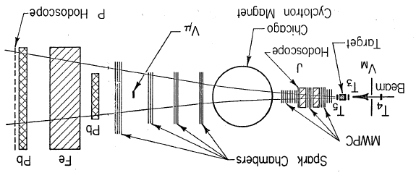
E 331
in the
Muon Lab

Slide 23
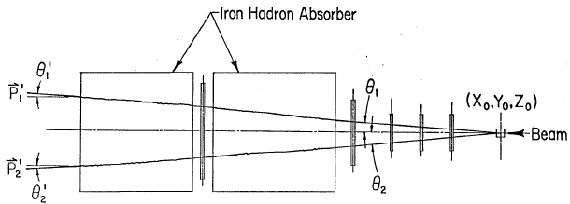
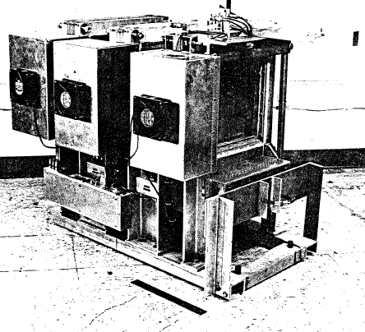
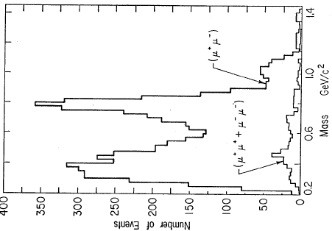
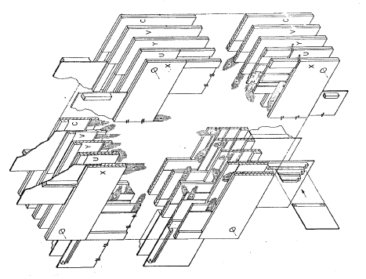

Slide 24
E 331 chronology
Approved in Jan 1975, very aggressive schedule.
Short test run in Spring 75
Burst on the scene in summer 1975 with ~100 J’s
400 hour run in winter-spring 1976.
Intensive analysis effort targeted for the ICHEP conference in Tbilisi, Georgia in July.
Jim sent in 2 papers based on early low-mass running.
I brought 3 post-deadline papers and submitted them the night before the conference.
They gave us invited talks in a gesture of cold-war hospitality.

Slide 25
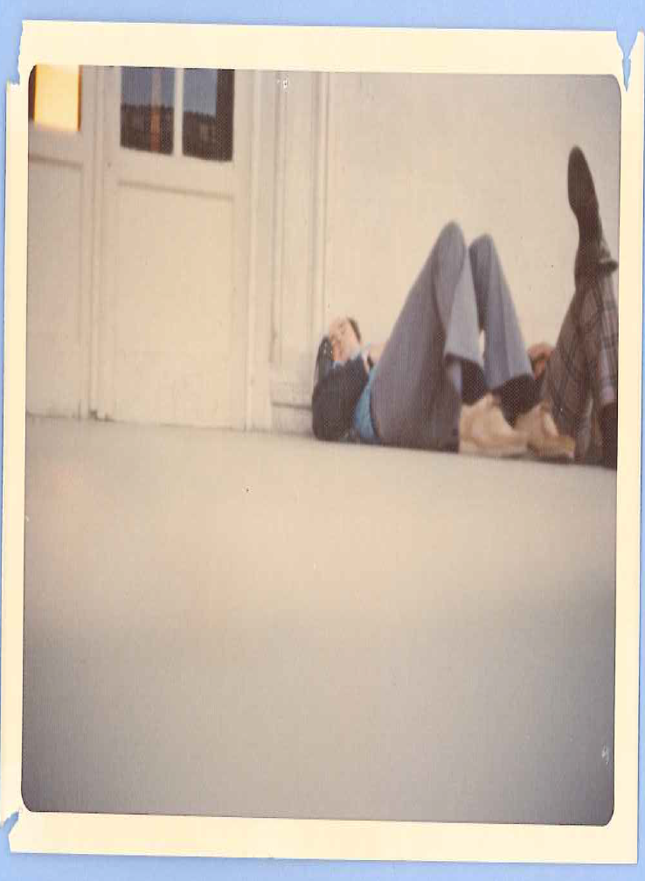
ICHEP in Tbilisi 1976 Welcome to Georgia!

Slide 26
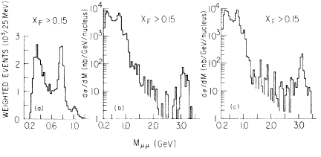
Mu-pair mass spectra, low-mass running
Pion
induced
Proton
induced
x_{F} = p*_{L}/ p*_{max}

Slide 27
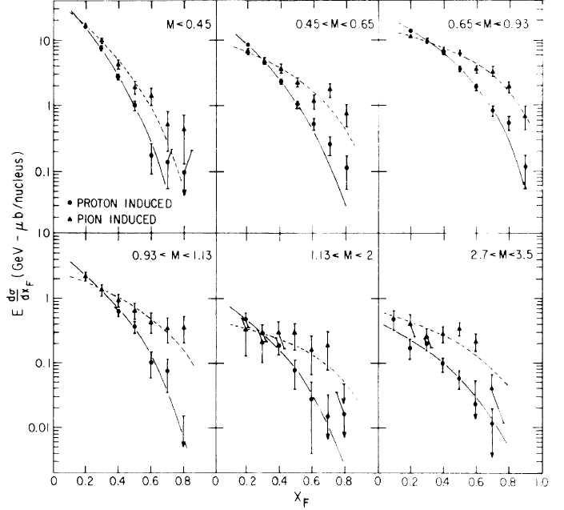
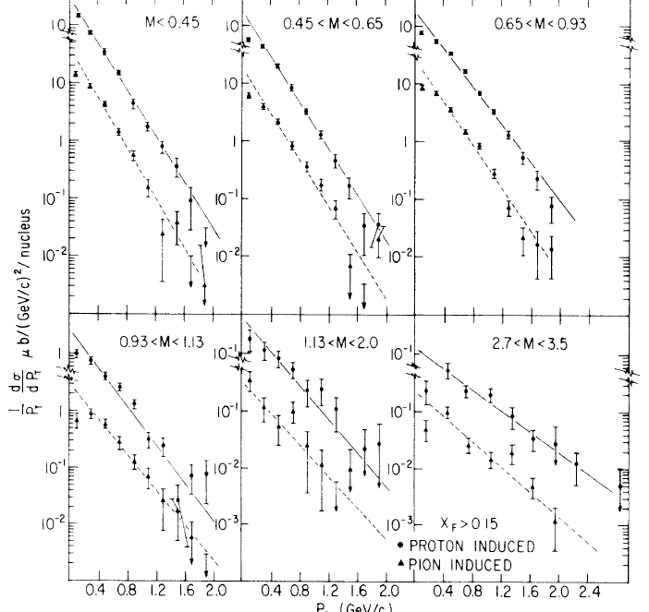
The only experiment with comprehensive acceptance

Slide 28
The pattern is similar throughout the mass range
P _{T}

Slide 29
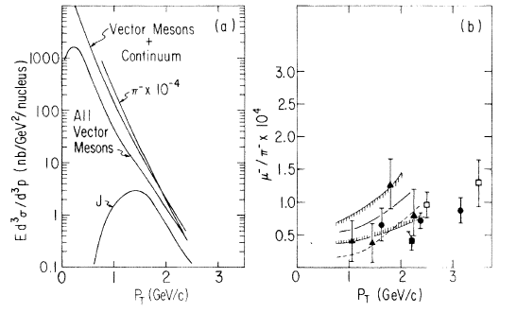
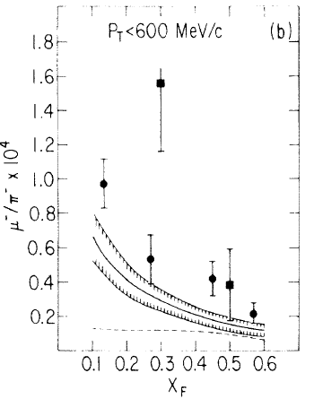

Slide 30
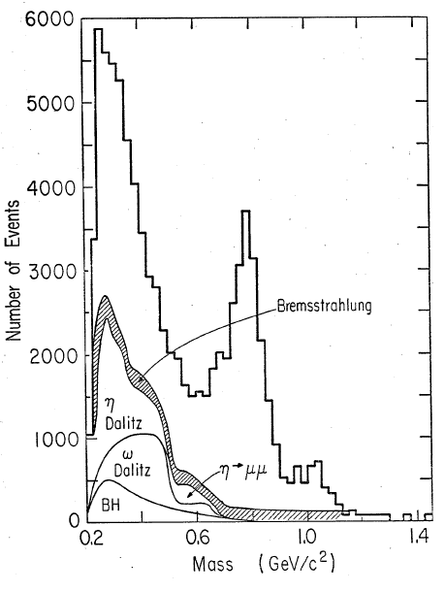
Can we explain the low-mass continuum?

Slide 31
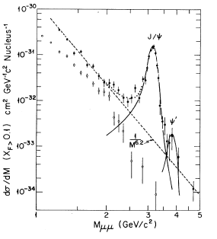
“High-mass running” search for Drell-Yan begins
Increase beam energy from 150 to 225 Gev/c to raise cross sections
Increase intensity to 10⁷/pulse
factor 20 for negative
3-4 for positives
New trigger to suppress low-mass pairs
(M<1.5 GeV/c²)
Retire the upstream MWPC’s

Slide 32
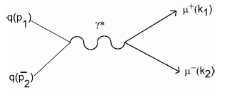
“Naïve” Drell-Yan: Valence quarks dominate
Target
(p, n)
Beam
(p, π ±)
CRISP PREDICTIONS
σ ~ e² of annihilating beam and target quarks
σ(p A) << σ(π ± A)
σ(π⁺ C) = ¼ σ(π⁻ C)
a
σ ~ A of target nucleus

Slide 33
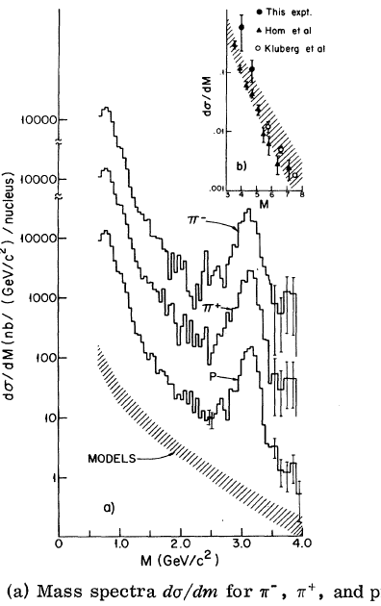
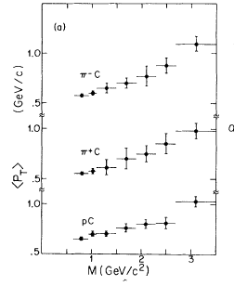
Hints of Drell Yan

Slide 34
Strong hints of Drell Yan
σ(Sn) / σ(C) = [A(Sn) / A(C)]^{α}

Slide 35
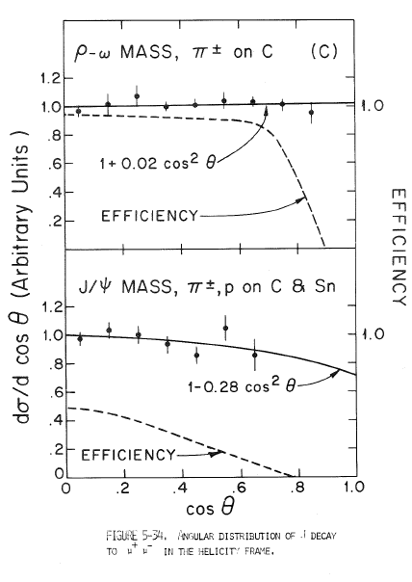
To make progress we needed to upgrade the beam and detector
Need to collect pairs in mass range > 4 GeV/c²
Cross section falls off quickly with mass
⇨Higher intensity beam
Acceptance in helicity angle is poor even at the J/ψ mass.
⇨ Wider upstream
MWPC coverage

Slide 36
E 444 – an extension that escalated into a new experiment
Goals – to measure pairs with M > 4 GeV/c² to test Drell-Yan
and then measure pion structure function.
Improved Beam
~20-fold increase in π⁻ beam flux; ~4-fold in p, π⁺
Quad-triplet focusing vs. bare horn
225 vs 150 GeV/c
New Cerenkov’s for better p / K / π separation
Larger acceptance in x_{F} and cosθ*
Upstream MWPC coverage grows from 1x1m² to 1x2m²
Trigger to suppress low-mass pairs, upgraded DAQ
Great students! (Kathy Newman-Holmes)

Slide 37
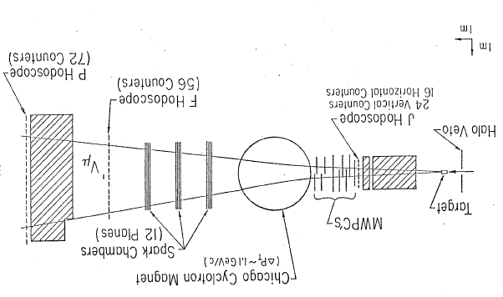
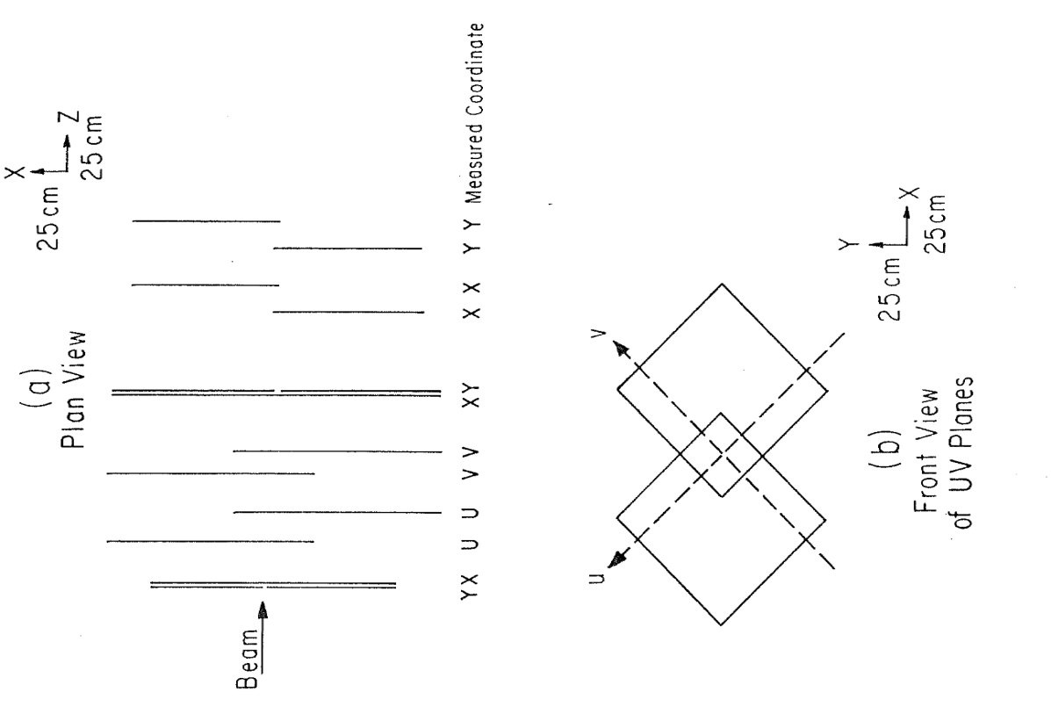

Slide 38
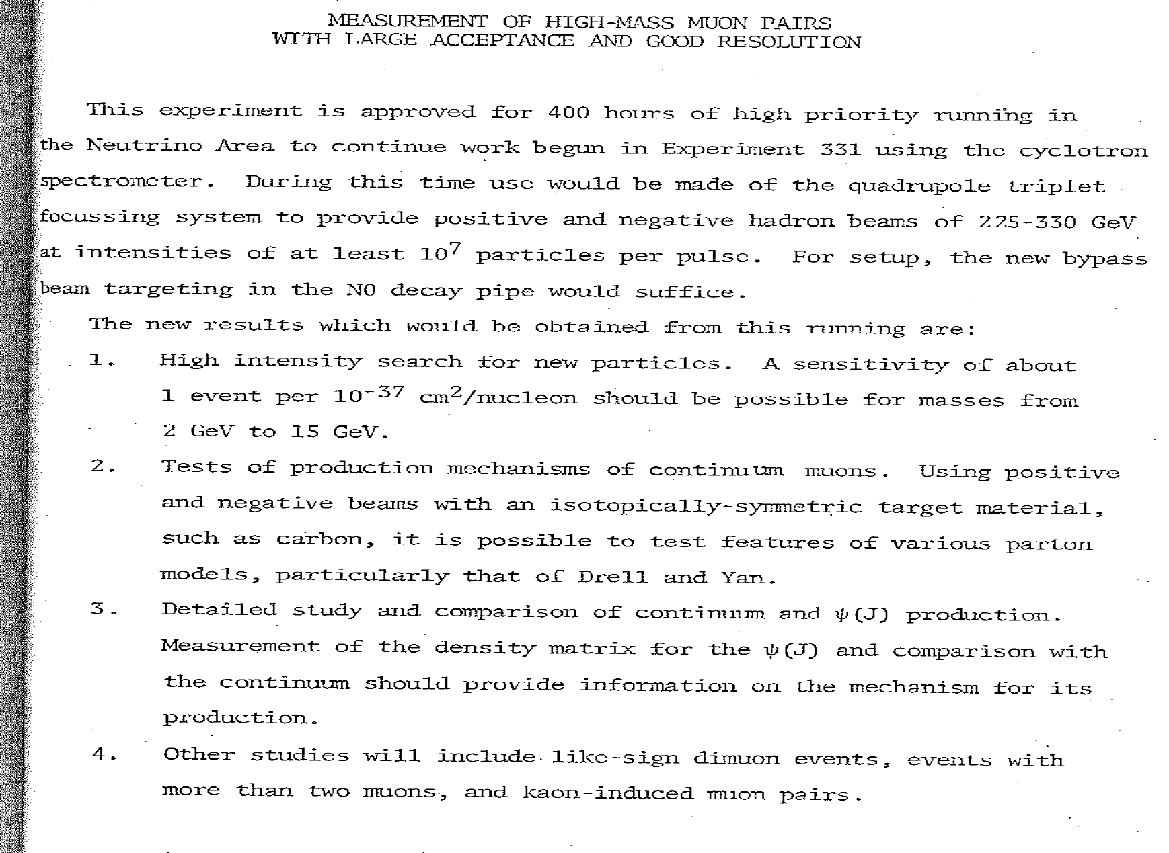
E-444

Slide 39
A few concluding remarks
We all enjoyed this thrilling time in physics immensely, and I feel blessed to have had more than 10 years with such a brilliant partner and friend.
Jim’s inspiring leadership has encouraged a host of outstanding young people into particle physics, a phenomenon that continues to this day.
As my colleagues increasingly take their “extended leaves from departmental obligations,” I have observed them to use this new freedom to focus on the science they love, and am thus very confident we’re all going to see as much or hopefully even more of Jim and Carla in the future.

Slide 40
BACKUP SLIDES

Slide 41
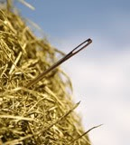
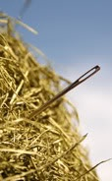
Searching for K⁺ → π⁺νν
A Needle in a Haystack!

Slide 42
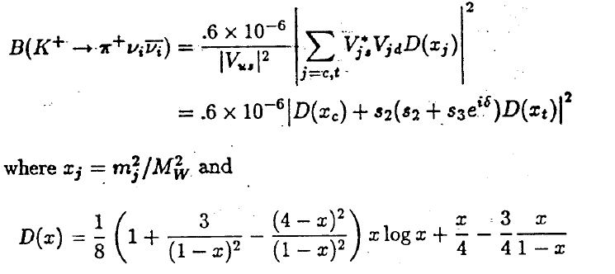
K⁺→π⁺νν in the Standard Model
⋅
⋅
⋅
⋅
No long-range couplings
GIM cancellation is spoiled by quark-mass effects, so that
Inami and
Lim, 1981

Slide 43
K→πνν and the Unitarity Triangle
Product of 1st and 3rd columns
V_{ud}V*_{ub}+ V_{cd} V*_{cb}+ V_{td}V*_{tb} = 0
Im
K⁰_{L}→π⁰νν
B_{d}, B_{S} Mixing
K⁺→π⁺νν
Re

Slide 44
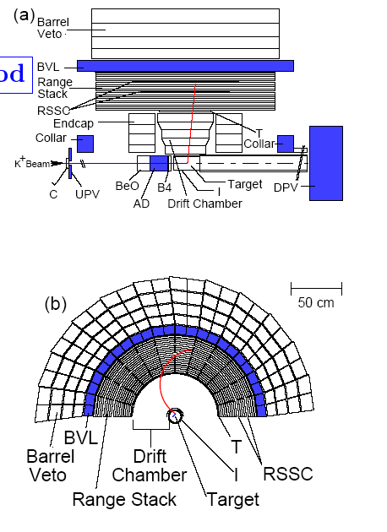
E787 – A “zero-energy” 4π collider detector

Slide 45
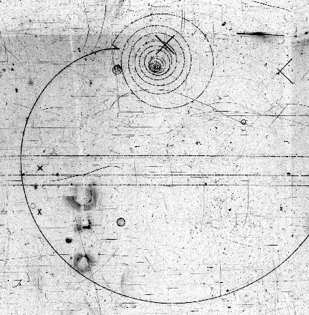
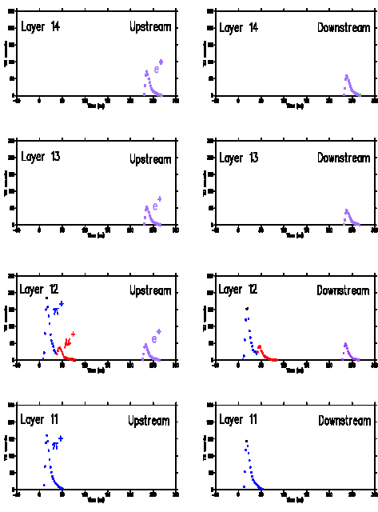
E787 – A “zero-energy” 4π collider detector
e⁺
Incoming 700MeV/c K⁺: identified & tracked by beam instrumentation. Slowed by energy loss in a BeO “degrader”
μ⁺
π⁺
K⁺ stops & decays at rest in scintillating fiber target – wait 2ns to make sure
Outgoing π⁺: verified by counters. Momentum measured in small drift chamber, energy & range in target & RS (1T magnetic field parallel to beam)
π⁺ beam events
π⁺ stops & decays in RS – detect π⁺→μ⁺ →e⁺ chain
Photons registered by all systems so events can be eliminated
July 2005
Notes:
45

Slide 46
APS Centennial Logo

Slide 47
Final Combined E787/949 Result
7 events
1.73
+1.15
-1.05
(68% CL interval)
c.f. SM prediction: (0.78±0.08) x 10⁻¹⁰

Slide 48
CPV was still an unresolved issue at the Millenium
CP Violation in K decay failed by factors of billions to account for the amount of matter surviving annihilation in the early universe.
Even after 36 years of vigorous experimental onslaught and increase in precision, no other manifestations of CP violation were observed.
Is there CP violation beyond the neutral kaon system?
Is Kobayashi-Maskawa’s idea the answer?
Is there direct CP violation?
What got rid of the antimatter?

Slide 49
Standard model to the rescue (1973) (Cabibbo-Kobayashi-Maskawa)
t
W
_
W
t
CKM Matrix: Unitary, specified by only 4 independent real parameters
CP violating phase

Slide 50
Observation of c and b quarks made CKM the leading candidate to explain CPV
b quark discovered in 1977 at Fermilab, studied systematically at Cornell and DESY for 20 years.
B lifetime found to be “long” (1.5 ps)
B⁰ – B⁰ mixing observed and well measured.
Potentially large CP Asymmetries (0.5 vs 0.002).
Alas, not measurable at available accelerators.
Two similar special-purpose e+e- colliders, the “B Factories,” came on line in 1999 at Stanford and in Tsukuba Japan, tuned to Ecm =10.53 GeV
Main goal -- to discover and characterise CP violation.
To do this, they needed ~100 times as much “luminosity” as produced by previous accelerators
Even more challenging, the beams had to have different energies, for reasons to be explained

Slide 51
Asymmetric B Factory
An e⁺e⁻ collider with different beam energies tuned at
the Y(4S): E ⁻ = 9.0 GeV E ⁺ = 3.1 GeV
At a conventional collider B’s would fly only ~25 μm
But at the B factory the Y(4S) and the ensuing BB system move in the laboratory, increasing the flight path more than tenfold, to ~ 260 μm
Not a piece of cake, but now within range of a
Silicon Detector.
e⁻
e⁺
ϒ (4S)
Δz

Slide 52
BABAR Detector 1999 — 2008

Slide 53
Measuring CKM angles in the B⁰_{d} system
B⁰→ππ, ρρ, ρπ, a⁰π
B.R. ~ few 10⁻ ⁶
α
V_{ud}V*_{ub}+ V_{cd} V*_{cb}+ V_{td}V*_{tb} = 0
V_{td}
~500 fb⁻¹
needed for a first pass
V_{ub}
γ
β
B⁰→J/ψK⁰_{S}
B⁰→DK
V_{cb}
Very clean,
Eff B.R. ~ 10⁻ ⁴
Useful BR ~10⁻⁷
Tough!!

Slide 54
Putting it all together – 2008 Nobel Prize for Kobayashi and Maskawa:
Good consistency with CKM picture, even with tight constraint from Bs Mixing
New Physics now has to show up as a correction.
“Tensions” are emerging,
to be resolved by new precision experiments

Slide 55
Direct CPV: Rate asymmetries
(B → f ) − Γ(B → f )
SUM
A_{CP} =
Only one process
with A_{cp} > 4 σ
A _{CP}

Slide 56
Largest Direct CP Violation ever!
(B → f ) − Γ(B → f )
SUM
A_{CP} =
To be compared to A_{CP} ~10 ⁻⁶ in K decays
Intense theoretical activity to see if it can be explained by SM
LHCb will have many other channels to look at.

Slide 57
Simultaneously, the “end” of the Kaon story in 2002
|ε| = (2.23 ± 0.01) x 10⁻³ Re(ε'/ε) = (1.65 ± 0.26) x 10⁻³

Slide 58
What does all this mean?
B factory experiments and recently CDF, D0 and LHCb provide sensitive over-constrained tests of the CKM “Unitarity triangle.”
Almost certainly means the Standard Model is also the source of original CP violation in Kaons.
After 47 years the source of the cosmological CP violation is still hiding out there somewhere!

Slide 59
(Cabibbo-Kobayashi-Maskawa) (1973)
t
W
_
W
t
CKM Matrix: Unitary, specified by only 4 independent real parameters
CP violating phase

